Slide 1
End-to-end seismic risk analysis framework for the identification of infrastructure network retrofits
Jason Wu
Advisor: Professor Jack Baker
Doctoral Defense
Stanford University, July 20, 2017
Notes:
Thank for the kind introduction. Hello and good afternoon everyone! I’m glad y’all could make it to the public portion of my doctoral defense. Today I will be sharing a portion of my dissertation titled “End-to-end seismic risk analysis framework for the identification of infrastructure network retrofits”

Slide 2
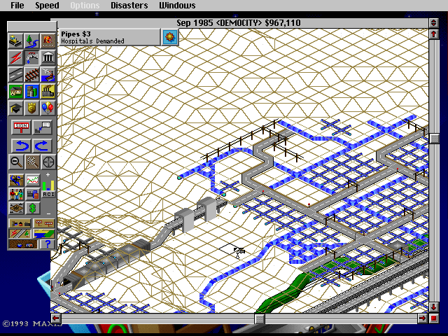
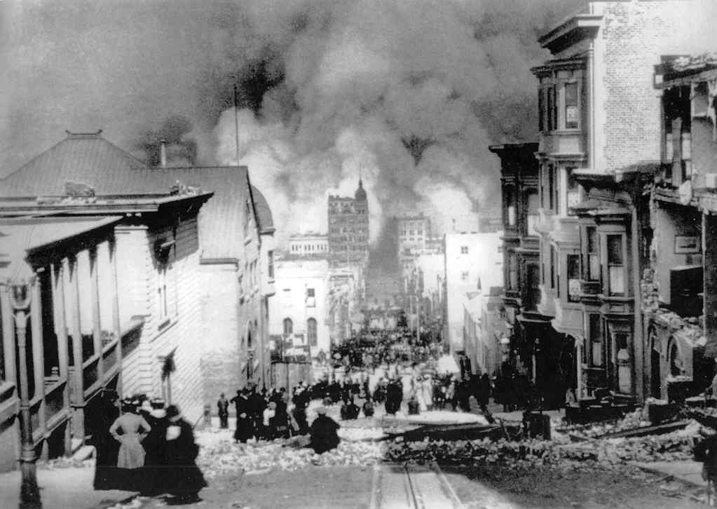
Infrastructure Networks are Important!
Infrastructure networks are the lifeblood of modern society.
Functionality of networks is critical for post disaster response.
Functionality of networks is key for the recovery of communities.
Image courtesy of www.oldgames.sk
Photo courtesy of kingsacademy.com
Notes:
I hope that it goes without saying that infrastructure networks are pretty important.
----
Lifeline networks, like power and water, are the lifeblood of modern society. Buildings need power, water, and gas to function, people need roads and bridges to get to places, and telecommunications to conduct business. Their failures have been associated with significant economic losses from business interruption and endangerment of lives.
-----
They are also critical for post disaster response. Emergency medical facilities need to be supplied clean water and power to help the injured. Closer to home, water is needed to fight any fires following earthquakes. And in fact, I had spoken with someone who used to be a medic in the military, and now works as an emergency responder; and he told me that the most important thing to him, is that people are able to contact him after an event. Because if doesn’t know where they are, he can’t go and save them. This highlights the importance of the telecom and power networks after an event.
-----
And finally, post disaster functionality of networks are linked to the recovery of communities, as well as the magnitude of long term socio-economic impacts.
Therefore, we need to take care of our networks; and if needed, strengthen them against future events. But how do we do so? As it turns out, this is pretty difficult to do.

Slide 3
Scenario Analysis
M_{W} 7.9, North San Andreas
Image courtesy of AECOM & AGS, CAPSS
Notes:
One popular method is something called a scenario analysis, in which, in the case of earthquakes, we subject, our networks to ground motion from a particular earthquake scenario, a scenario being a particular fault rupturing at a particular location, with a particular magnitude. For example, here is a picture of a ground motion map that depicts ground shaking intensity associated with a magnitude 7.9 earthquake resulting from a rupture of the North San Andreas fault. These ground motions are actually used in a real life project called the Community Action Plan for Seismic Safety, or CAPSS for short. CAPSS uses the ground motions from this scenario and a handful of others for decision making regarding the buildings and networks in San Francisco.
However, one of the major issues of this strategy is that, while these are significant earthquakes, they do not necessarily reflect all future earthquakes. The chosen scenarios are a small sample of a huge range of possibilities. For example, there is a wide range of possible magnitudes, as well as location and extent of the fault rupture that these ground motions may not capture. Additionally, even for a particular scenario, there is variability in the ground motion, so this picture is one of the many possibilities even for this exact scenario.
There are other issues with this picture, but I won’t get into that in the interest of time.

Slide 4
Probabilistic Analysis
Mw 8.05 North San Andreas
Mw 6.9 Hayward
Mw 6.5 Calaveras
…
Notes:
A more desirable alternative is something called probabilistic analysis, in which || multiple realizations of the ground motion from a particular scenario are sampled
---------
And we do this for all possible scenarios.

Slide 5
Probabilistic Analysis
Multiple Ground Motion Maps
Multiple Network Analyses
Notes:
We would then subject our network to these ground motion maps and perform a reliability analysis.
Now, as you can imagine, enumerating all of these ground motions, and then conducting that many network analyses is very computationally costly, and not very attractive to decision makers who have limited time and limited resources. However, the rigor that this strategy provides, as well as the fidelity of the decisions made using this strategy are invaluable. You can say that this is our best guess about future earthquakes, and we should really try to use that.
Therefore, my work pursues probabilistic analysis and tries to mitigate this issue of computational expense.

Slide 6
Objectives of this Dissertation
Facilitate probabilistic analysis of infrastructure network reliability.
Notes:
With that desire in mind, the objectives of my dissertation can be summarized into these main points.
------
First, I want to facilitate probabilistic analysis of infrastructure network reliability. I want to inform and teach people about probabilistic analysis and prove that it is worth conducting.

Slide 7
Objectives of this Dissertation
Facilitate probabilistic analysis of infrastructure network reliability.
Integrate seismic risk of network components to enable risk informed retrofit selection.
Notes:
Second, and this goes hand in hand with the first point, I want to integrate the probabilistic seismic risk analysis into mitigation planning, and perform risk informed retrofit selection.

Slide 8
Objectives of this Dissertation
Facilitate probabilistic analysis of infrastructure network reliability.
Integrate seismic risk of network components to enable risk informed retrofit selection.
Develop methods that are rigorous but computationally tractable for complex networks.
Notes:
Finally, I want to propose methods that are rigorous, but also computationally efficient such that a probabilistic analysis of large complex networks is still tractable.
1-8
~5:00

Slide 9
Areas of Contribution
Hazard characterization
Chapter 3 Ground Motion Amplitude Field Simulation
Network performance estimation
Chapter 5 Statistical Learning Application
Network Component Retrofit Selection
Chapter 4 Risk Informed Retrofitting Heuristics
Notes:
In pursuit of these objectives, this dissertation contributes to the following areas.
------------------------
First, in the area of hazard characterization, chapter 3 identifies efficient techniques for the simulation of ground motion maps, or more specifically, ground motion amplitude fields.
------------------------
Second, in the area of network performance estimation, chapter 5 applies statistical learning techniques to more efficiently estimate network performance.
------------------------
Then, in the area of network retrofitting, chapter 4 proposes risk informed heuristics to select efficient and effective retrofits, with a particular focus on pipes of water supply networks.

Slide 10
Areas of Contribution
Hazard characterization
Chapter 3 Ground Motion Amplitude Field Simulation
Network performance estimation
Chapter 5 Statistical Learning Application
Network Component Retrofit Selection
Chapter 4 Risk Informed Retrofitting Heuristics
Chapter 2 End-to-End Framework
Notes:
And finally, chapter 2 of this dissertation proposes an end to end framework that ties all of these topics together.

Slide 11
Areas of Contribution
Hazard characterization
Chapter 3 Ground Motion Amplitude Field Simulation
Network performance estimation
Chapter 5 Statistical Learning Application
Network Component Retrofit Selection
Chapter 4 Risk Informed Retrofitting Heuristics
Chapter 2 End-to-End Framework
Notes:
In the interest of time, this presentation will mostly focus on findings from Chapters 4 and 5, and briefly discuss the framework in Chapter 2 for context.

Slide 12
Water Networks
Source Node
Pipeline
Distribution Node
Notes:
But before I start, let me describe the components of water networks.
----------
First, water networks have source nodes, points at which water is introduced to the network. Reservoirs and tanks are examples of source nodes.
----------
Then, water traverses from the source nodes to the rest of the network through pipelines.
Finally, water is consumed at distribution nodes, at various points downstream of the source nodes. Each distribution node demands a certain quantity of water. And if that demand is not met, then there is some adverse impact to the customers being serviced by that distribution node.
----------
Here are some possible locations of distribution nodes in this network.

Slide 13
Water Networks
Pipe Damage
Notes:
Then, these components of the water network could be damaged after an earthquake. For simplicity, this dissertation only considers damage to pipes. There are two primary types of damage to pipes—pipe leaks and pipe breaks.

Slide 14
Water Networks
Pipe Leak
Notes:
Pipe leaks are usually tears in the pipe wall or pipe joints such that some of the water leaks out, though some of the water does make it through the pipe.

Slide 15
Water Networks
Pipe Break
Notes:
Pipe breaks on the other hand involve full disconnection of the pipe that results in all of the water spilling out.
I will be referring to this small example network to demonstrate concepts discussed later in this presentation

Slide 16
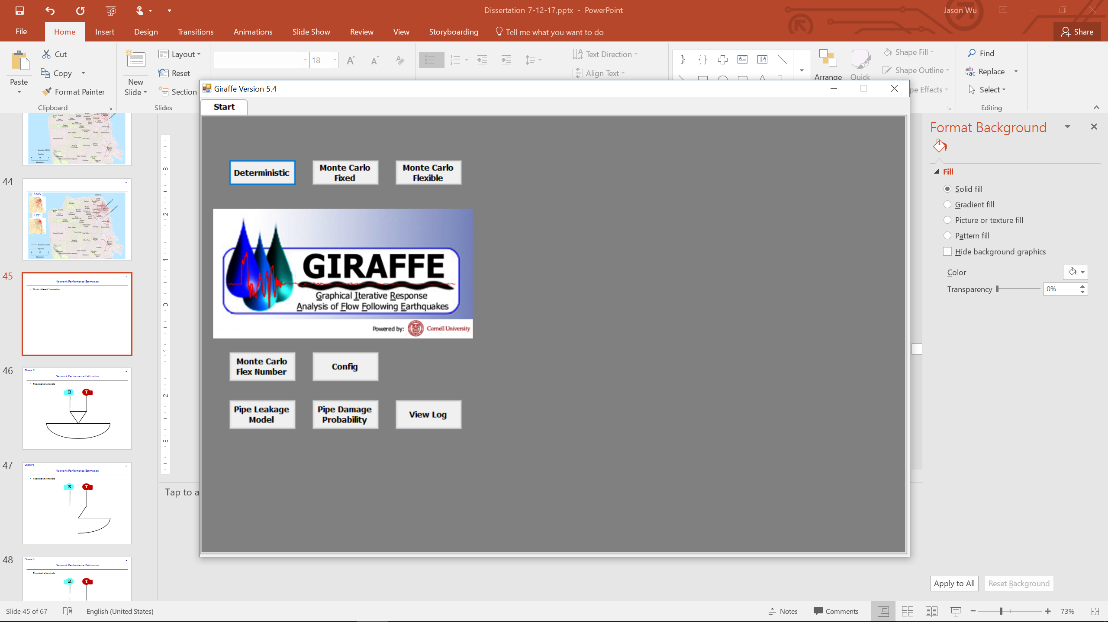
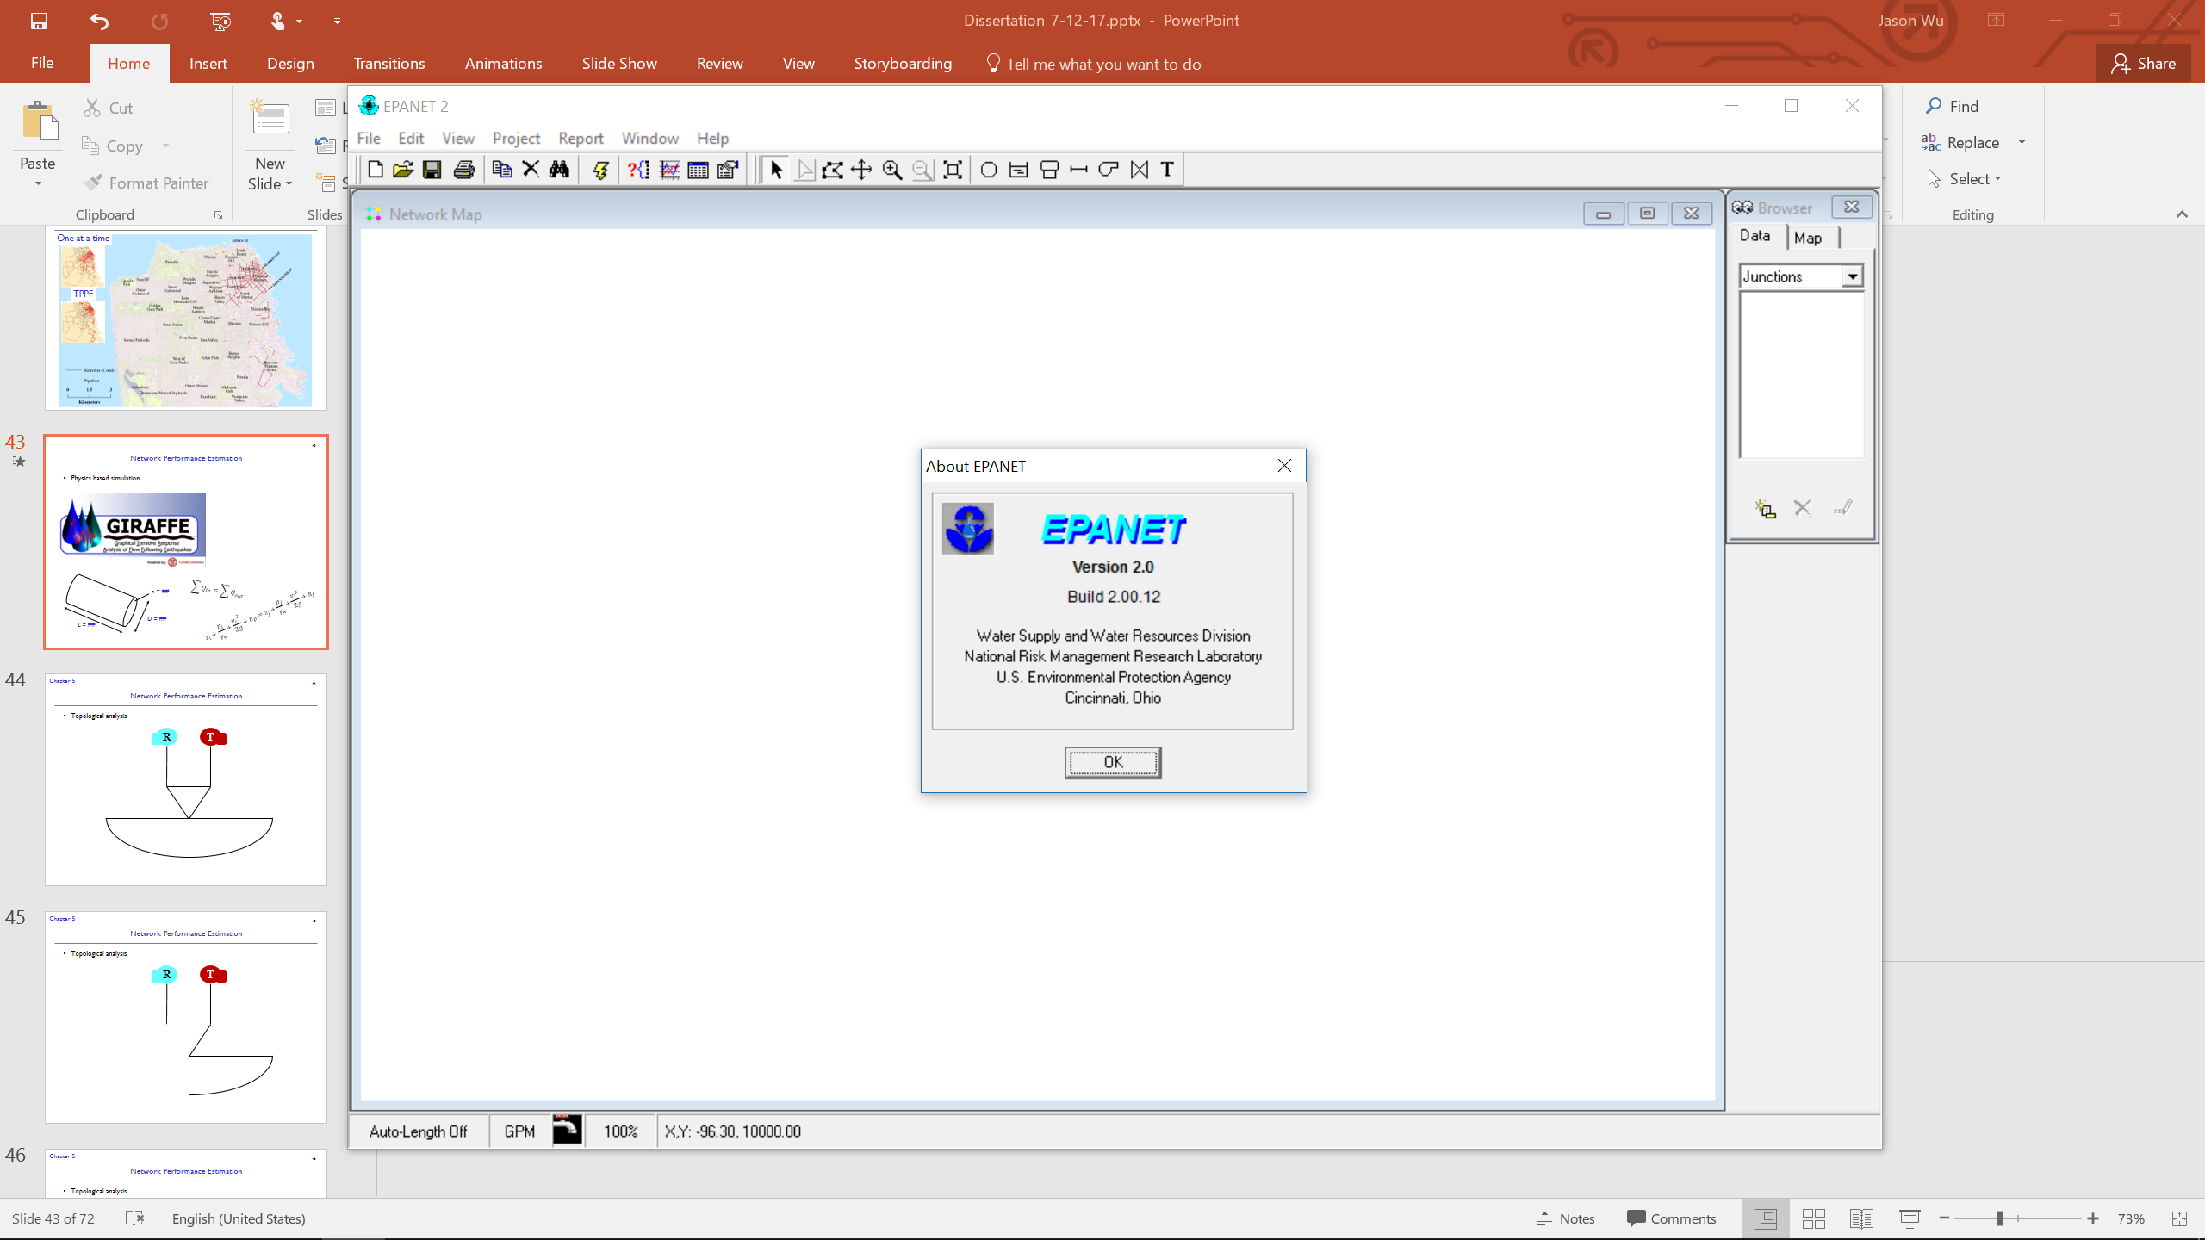
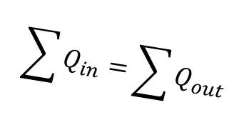
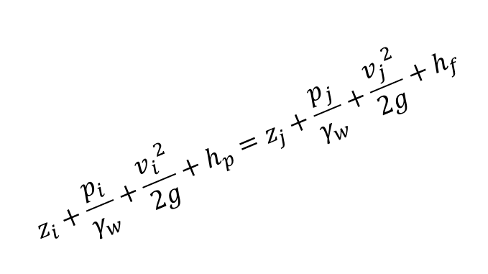
Network Performance Estimation
Physics based, hydraulic flow simulation
$$\begin{matrix} \\ \sum{Q_{in}}=\sum{Q_{out}}\end{matrix}$$
n = ##
Pipe
$$\begin{matrix} \\ z_{i}+\frac{p_{i}}{γ_{w}}+\frac{{v_{i}}^{2}}{2g}+h_{p}=z_{j}+\frac{p_{j}}{γ_{w}}+\frac{{v_{j}}^{2}}{2g}+h_{f}\end{matrix}$$
D = ##
L = ##
Notes:
We analyze our networks using a physics based, hydraulic flow simulation model
-----------------------
Specifically, I use GIRAFFE, a program developed at Cornell University that uses the engine of EPANET, which is a hydraulic flow simulation program developed by the EPA. These programs incorporate
----------------
network component properties
----------------
And governing physical equations to simulate the network behavior.

Slide 17
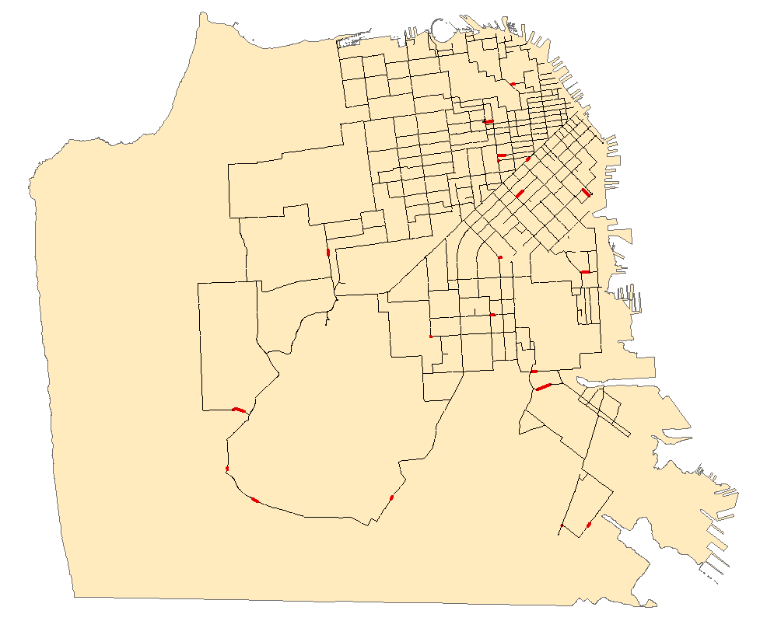
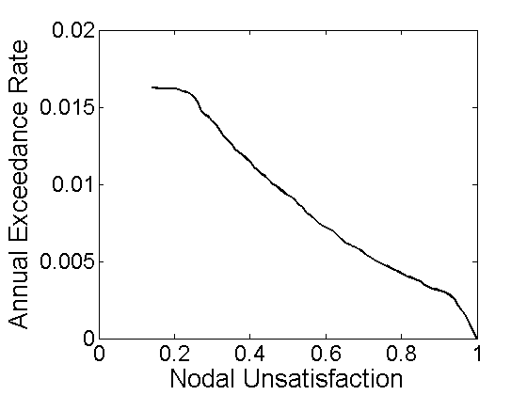
Network Performance Estimation
Physics based, hydraulic flow simulation
Network Component Damage
Network Performance
Notes:
And what these hydraulic simulation models allows us to do is to translate network component damage into a measure of network performance, which I will discuss more in detail in a bit.

Slide 18
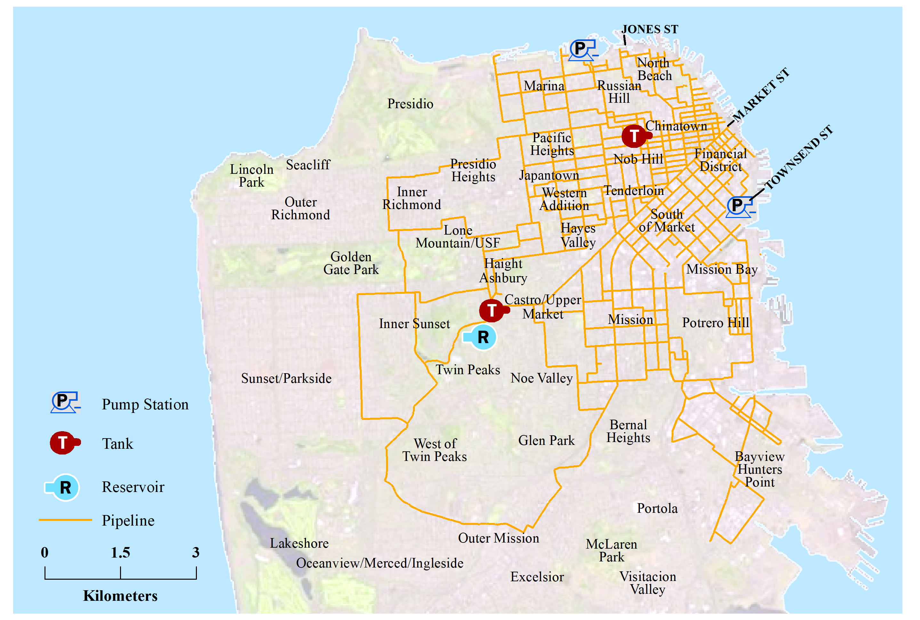
Auxiliary Water Supply System (AWSS) of San Francisco
Notes:
All of the calculations and results use this case study network, the Auxiliary Water Supply System, or AWSS, of San Francisco. The AWSS was actually initially constructed in the early 1900s as a response to the 1906 earthquake to specifically fight fires following earthquakes. If you go around San Francisco today, you might see bits and parts of it peeking out. I believe the hydrants connected to the AWSS are colored blue.

Slide 19
Auxiliary Water Supply System of San Francisco
Twin Peaks Reservoir
Photo Courtesy of AECOM/AGS JV (sfwater.org)
Notes:
Here is a photo of the Twin Peaks Reservoir, pretty isn’t it?

Slide 20
Auxiliary Water Supply System of San Francisco
Pump Station No. 2
Photo Courtesy of AECOM/AGS JV (sfwater.org)
Notes:
And here is a photo of a pump at pumping station number 2 near Jones Street
With this network in mind, let me tell you about what I’ve been doing.
9-20
~4:00
------
9:00

Slide 21
End-to-End Seismic Risk Analysis and Retrofitting Framework
Chapter 2
Hazard Characterization
Network Performance Estimation
Component Retrofit Selection
Notes:
Chapter 2 proposes an end-to-end seismic risk analysis and retrofitting framework that encompasses the following modules: hazard characterization, in the context of probabilistic analysis, network performance estimation, and network component retrofit selection. I will briefly discuss each of these modules and the methods used in this dissertation.

Slide 22
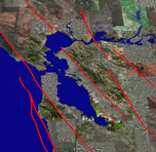
Hazard Characterization
Chapter 2
Enumerate possible future earthquake scenarios.
Image courtesy of USGS
Notes:
Hazard characterization involves the modeling of potential future earthquakes.
Ideally, I would just predict the future, know what the ground shaking is, and then act accordingly.
However, since I can’t do that, the next best thing is to think about all of the different possible earthquakes that might happen.
----------------------
First, I need to enumerate all possible future earthquake scenarios, considering all faults, magnitudes, rupture locations and extents, etc.

Slide 23
Hazard Characterization
Chapter 2
Enumerate possible future earthquake scenarios.
Obtain realizations of ground motion maps
Notes:
Then, I simulate ground motion for each of these scenarios, considering the variability of that ground motion, as well as spatial correlation between nearby areas—these plots should look familiar.

Slide 24
Hazard Characterization
Chapter 2
Enumerate possible future earthquake scenarios.
Obtain realizations of ground motion maps
Optimize the set of ground motion maps
Notes:
Finally, I can optimized this set of ground motion maps and obtain a smaller subset of hazard consistent maps to work with. The details of this step are a bit complex, so I’ll let you read about it in the dissertation.
Once I have characterized the hazard, I feed this information into the next module, network performance estimation.

Slide 25
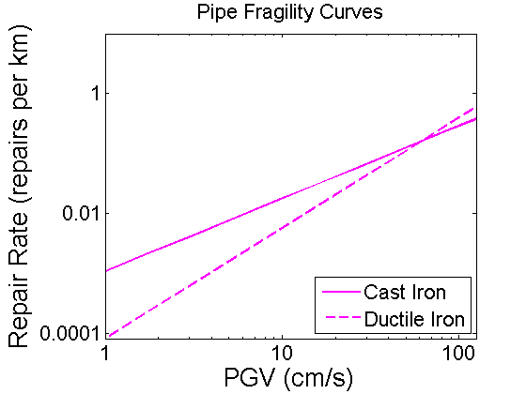
Network Performance Estimation
Chapter 2
Calculate network component probability of failure.
Peak Ground Velocity (cm/s)
Notes:
In this module, we estimate the behavior of the network in response to the ground motions that it is subjected to.
First, for each ground motion map, we calculate the probabilities of failures of our network components. For example, this plot shows the fragilities curves that relate peak ground velocity, a measure of ground shaking intensity, with the probability of failure of pipes, measured by what we call the repair rate.

Slide 26
Network Performance Estimation
Chapter 2
Calculate network component probability of failure.
Simulate component damage.
Notes:
Then, we sample these probabilities to obtain simulations of pipe damage.

Slide 27
Network Performance Estimation
Chapter 2
Calculate network component probability of failure.
Simulate component damage.
Estimate network performance due to that damage. (Hydraulic flow simulation)
Notes:
Then, we feed the pipe damage into a network model and estimate its performance. Again I am using a physics based hydraulic flow model to simulate the network behavior.

Slide 28

Network Performance Estimation
Chapter 2
Calculate network component probability of failure.
Simulate component damage.
Estimate network performance due to that damage. (Hydraulic flow simulation)
20/20
5/20
Nodal Unsatisfaction – Proportion of nodes in the network with their water demands not satisfied.
Notes:
We measure network performance in terms of nodal unsatisfaction, which is defined to be the proportion of nodes in the network with their water demands not satisfied.
----------------------------
For example, looking at the distribution nodes of our network,
----------------------
suppose that the left node demands 20 units and receives 20 units,
--------------------
so we have a satisfied node.
-------------------------
Then, suppose that the right node also demands 20 units, but only receives 5,
-----------------------
so this node is not satisfied.
Therefore, 1 out of 2 distribution nodes do not have their demands satisfied, and the nodal unsatisfaction is 0.5.

Slide 29
Network Performance Estimation
Chapter 2
Calculate network component probability of failure.
Simulate component damage.
Estimate network performance due to that damage. (Hydraulic flow simulation)
Nodal Unsatisfaction – Proportion of nodes in the network with their water demands not satisfied.
Aggregate network performance over all ground motion maps
Notes:
After estimating the network performance due to all of our ground motion maps, the results are aggregated in a plot like this, where the x-axis describes nodal unsatisfaction, and the y-axis describes its exceedance probability. This plot describes the network risk due to seismic hazard.
Once I have my network risk, I can feed this information into the next module, network component retrofit selection

Slide 30
Component Retrofit Selection
Chapter 2
Select network components for retrofitting
Notes:
In this module, I select a subset of components to retrofit that I believe to best mitigate the impacts from future earthquakes.

Slide 31
Component Retrofit Selection
Chapter 2
Select network components for retrofitting
Integrate seismic risk considerations
Notes:
This dissertation uses seismic risk considerations to inform retrofit selection

Slide 32
Component Retrofit Selection
Chapter 2
Select network components for retrofitting
Integrate seismic risk considerations
Elaborated in Chapter 4
Notes:
And this is elaborated in Chapter 4 on retrofitting, which I will talk about now.
21-33
~5:00
------
14:00

Slide 33
Existing Retrofit Selection Techniques
Chapter 4
Optimization/Enumeration (e.g. Fan et al. 2010, Romero et al. 2016)
Notes:
There are a number of existing methods for retrofitting.
------------
First, we can try to generate all possible combinations of pipes to retrofit, perhaps subject to a budget constraint, and see which combination yields the best results.
--------------
For example, let’s take our example network

Slide 34
Existing Retrofit Selection Techniques
Chapter 4
Optimization/Enumeration (e.g. Fan et al. 2010, Romero et al. 2016)
Notes:
We can try retrofitting this pipeline and record the results.

Slide 35
Existing Retrofit Selection Techniques
Chapter 4
Optimization/Enumeration (e.g. Fan et al. 2010, Romero et al. 2016)
Notes:
Then we can try retrofitting this pipeline and record the results.

Slide 36
Existing Retrofit Selection Techniques
Chapter 4
Optimization/Enumeration (e.g. Fan et al. 2010, Romero et al. 2016)
Notes:
Then these pipelines

Slide 37
Existing Retrofit Selection Techniques
Chapter 4
Optimization/Enumeration (e.g. Fan et al. 2010, Romero et al. 2016)
Notes:
And perhaps these pipelines.
Once we have tested all of the different combinations, we just choose the best one. Now, this is not too difficult for a small network like this.

Slide 38
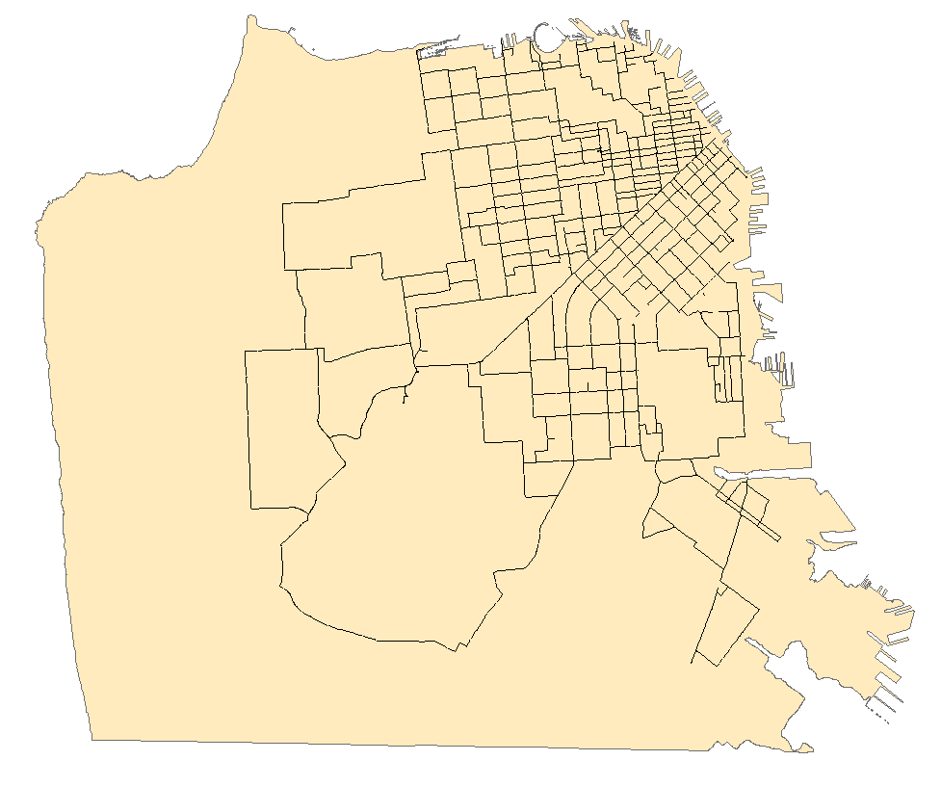
Existing Retrofit Selection Techniques
Chapter 4
Optimization/Enumeration (e.g. Fan et al. 2010, Romero et al. 2016)
Notes:
But what about something bigger and more complex, like our case study network, the AWSS?

Slide 39

Existing Retrofit Selection Techniques
Chapter 4
Optimization/Enumeration (e.g. Fan et al. 2010, Romero et al. 2016)
Notes:
Again, we can try retrofitting this pipeline

Slide 40

Existing Retrofit Selection Techniques
Chapter 4
Optimization/Enumeration (e.g. Fan et al. 2010, Romero et al. 2016)
Notes:
Or this one

Slide 41

Existing Retrofit Selection Techniques
Chapter 4
Optimization/Enumeration (e.g. Fan et al. 2010, Romero et al. 2016)
Notes:
Or this one

Slide 42

Existing Retrofit Selection Techniques
Chapter 4
Optimization/Enumeration (e.g. Fan et al. 2010, Romero et al. 2016)
Notes:
Or these two

Slide 43
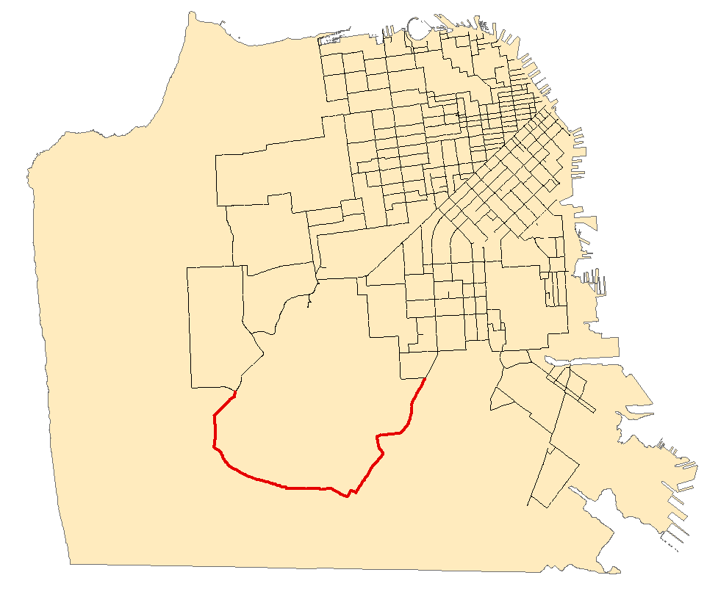
Existing Retrofit Selection Techniques
Chapter 4
Optimization/Enumeration (e.g. Fan et al. 2010, Romero et al. 2016)
Notes:
Or these pipes down here

Slide 44
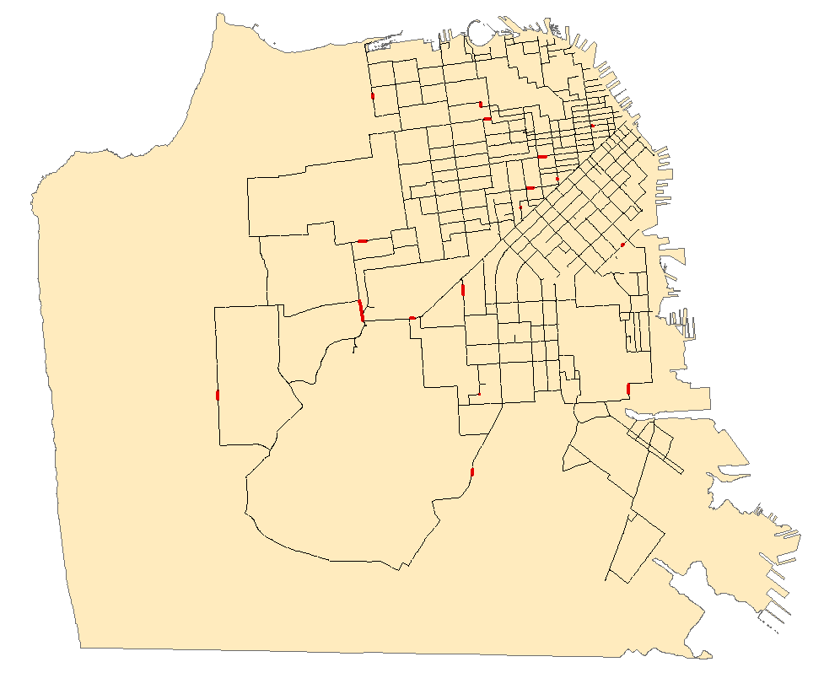
Existing Retrofit Selection Techniques
Chapter 4
Optimization/Enumeration (e.g. Fan et al. 2010, Romero et al. 2016)
Notes:
Or all of these pipes

Slide 45
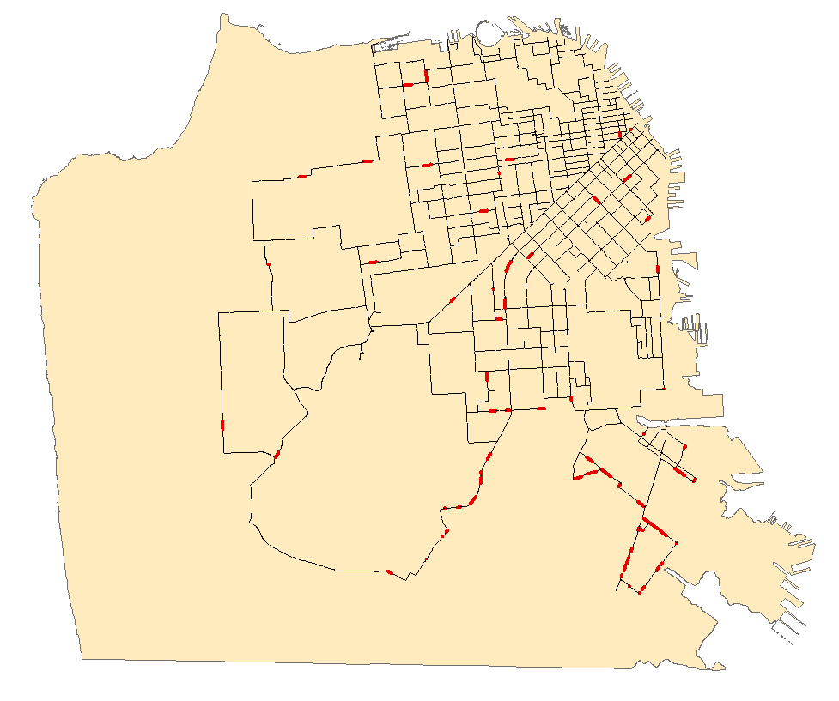
Existing Retrofit Selection Techniques
Chapter 4
Optimization/Enumeration (e.g. Fan et al. 2010, Romero et al. 2016)
Notes:
Or all of these pipes
As you can see, enumerating all the possibilities for a large network becomes nearly impossible to do. So instead, perhaps we can use some heuristics that help us identify important pipes and tell us which pipes to retrofit. But what heuristics should we use?

Slide 46
Estimating Pipe Importance via Heuristics
Chapter 4
Most likely to be damaged
Break one at a time (Risk Achievement Worth; Rausand and Høyland 2004, Salman et al. 2015)
Weight its impact on the network by its probability of damage from a seismic hazard analysis. (Caltrans Seismic Design Criteria Version 1.7, Caltrans 2013)
Notes:
Well first, we can think about retrofitting those pipes that are most likely to be damaged. However, these pipe might not be important to network functionality.
Then, one popular heuristic is to just break pipes one at a time, and see how the network performs with that pipe broken. The pipes that most impact the network in this way are clearly important pipes, so we can select those to retrofit. However, this method neglects the probability of these pipes being damaged in future earthquakes. A pipe that is very important, but never breaks, would not be a good candidate to retrofit.
Alright, then what if we perform a seismic hazard analysis and weight its probability of failure with its criticality to network performance. We’re getting closer, but since we’re looking at one component at a time, we are still neglecting the effects of joint failures.

Slide 47
Proposed Retrofitting Method
Chapter 4
Theoretical Pipe Participation Factor (TPPF)
After probabilistic risk assessment, retrofit pipe segments that are likely to be damaged in simulations that result in poor network performance.
$${TPPF}_{Component i}=\frac{1}{{Length}_{Component i}}\frac{1}{\sum_{j∈S_{D}}{w_{j}}}\sum_{j∈S_{D}}{w_{j}P\left(x_{i,j}≥x\right)}$$
Notes:
This leads to a metric proposed in this dissertation called the Theoretical Pipe Participation Factor, or TPPF. This metric is how our probabilistic analysis is integrated into retrofit selection. After we perform our probabilistic assessment and have our network performance estimates from each simulation, TPPF selects pipes that are likely to be damaged in those simulations which resulted in poor network performance. So essentially, we are selecting pipes whose damage are correlated with network performance.

Slide 48
Proposed Retrofitting Method
Chapter 4
Theoretical Pipe Participation Factor (TPPF)
After probabilistic risk assessment, retrofit pipe segments that are likely to be damaged in simulations that result in poor network performance.
$${TPPF}_{Component i}=\frac{1}{{Length}_{Component i}}\frac{1}{\sum_{j∈S_{D}}{w_{j}}}\sum_{j∈S_{D}}{w_{j}P\left(x_{i,j}≥x\right)}$$
Find ground motion simulations/scenarios that result in high network disruption
(i.e. Nodal Unsatisfaction > 0.8)
Notes:
The key part of this formulation is this SD, which tells us to only consider simulations that led to poor network performance or conversely high network disruption.
In this dissertation, we choose simulations that result in a nodal unsatisfaction higher than 0.8, which means that at least 80% of nodes do not have enough water.

Slide 49
Proposed Retrofitting Method
Chapter 4
Theoretical Pipe Participation Factor (TPPF)
After probabilistic risk assessment, retrofit pipe segments that are likely to be damaged in simulations that result in poor network performance.
$${TPPF}_{Component i}=\frac{1}{{Length}_{Component i}}\frac{1}{\sum_{j∈S_{D}}{w_{j}}}\sum_{j∈S_{D}}{w_{j}P\left(x_{i,j}≥x\right)}$$
Identify pipes that are likely to break in those simulations
Notes:
Another key part is this term which captures those pipes that are likely to break in those simulations.

Slide 50
Proposed Retrofitting Method
Chapter 4
Theoretical Pipe Participation Factor (TPPF)
After probabilistic risk assessment, retrofit pipe segments that are likely to be damaged in simulations that result in poor network performance.
$${TPPF}_{Component i}=\frac{1}{{Length}_{Component i}}\frac{1}{\sum_{j∈S_{D}}{w_{j}}}\sum_{j∈S_{D}}{w_{j}P\left(x_{i,j}≥x\right)}$$
Likelihood of this scenario to occur
Notes:
And we also consider the likelihoods of these scenarios to occur.
This formulation provides a measure of pipe criticality to network functionality, incorporating pipe damage probabilities since we are using a hazard consistent set of ground motions.
Additionally, we implicitly consider joint failures, since we are damaging the network as a whole with these ground motion simulations, rather than damaging one component at a time.
Now, I would like to demonstrate and compare this proposed heuristic with other retrofitting techniques, and see how it fares.

Slide 51
Demonstration Details
Chapter 4
55 km of pipeline are selected for retrofit.
Retrofits reduce probability of damage to 0 for simplicity.
Recall: Network Performance
Notes:
To demonstrate the retrofitting, each retrofitting technique will select 55 kilometers of pipeline for retrofit, which corresponds to about a quarter of the network.
Pipes selected for retrofitting are made immune to damage, for simplicity and to make more explicit the differences between the retrofit strategies.
--------------
The effects of these retrofits will be measured by its impacts to this network performance curve. Retrofits that perform well will decrease the probability of nodal unsatisfaction, and shift this curve downward.

Slide 52
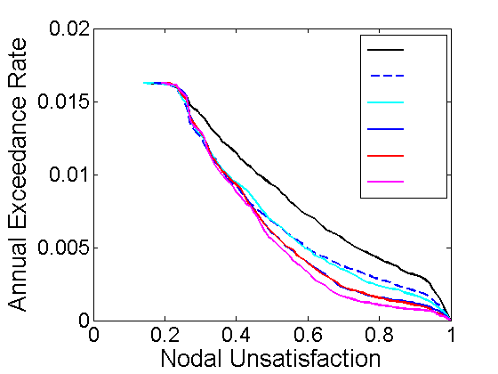
Retrofitting Results
Chapter 4
No Retrofits
Highest Damage Probability
Random Selection
Break Pipes One at a Time
TPPF (Proposed Method)
Combine the Above Two
Notes:
Here are some results regarding the impact of various retrofitting strategies. First, we have the solid black line, which is the network performance with no retrofits applied. This acts as a benchmark for comparison.
Next, we have the dashed blue line, in which the retrofitted pipes were pipes with high probability of damage due to ground motion, and the cyan line, in which pipes were just randomly selected for retrofitting. Interestingly, this plot indicates that selecting pipes only on the basis that they break often does not do better than random chance, in this case.
Next, we have the solid blue line, in which retrofits came from those pipes that most impact the network when broken one at a time, and the solid red line, which uses our proposed metric. Interestingly, and unfortunately for me I suppose, they seem to perform very similarly.
Then I thought, what would happen if I were to combine these two heuristics? This leads to the magenta line, which is clearly superior compared to the other retrofits. So even though the above two heuristics performed very similarly with each other, the combination of the two lead to an even more efficient retrofit scheme. This would imply that there was something that these heuristics individually lacked, but when combined, the shared information better captures what’s going on, leading to superior retrofits.
Let’s investigate this further.

Slide 53
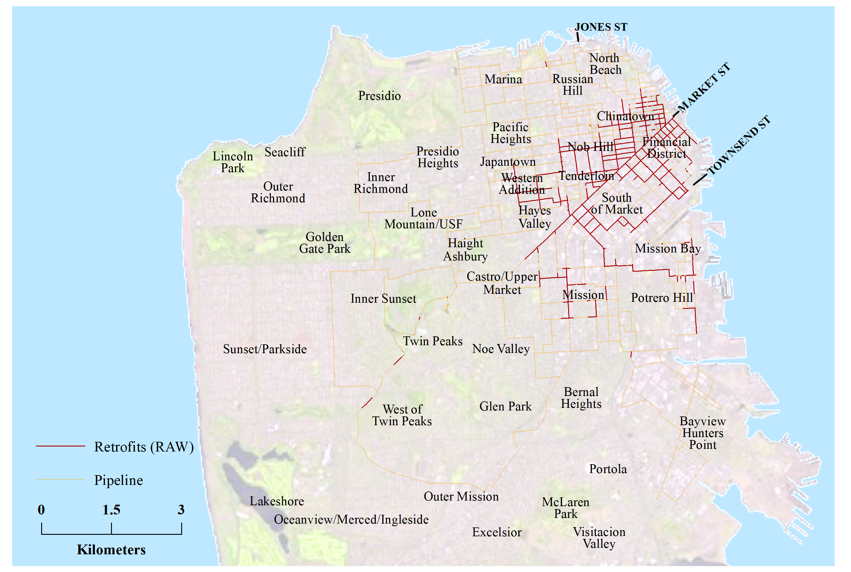
Break One at a Time Retrofits
Chapter 4
Notes:
This map depicts the retrofits selected using the break one at a time strategy. Note that the retrofits extend down market street, loop around south of market, and generally extend west from financial district to the western addition.

Slide 54
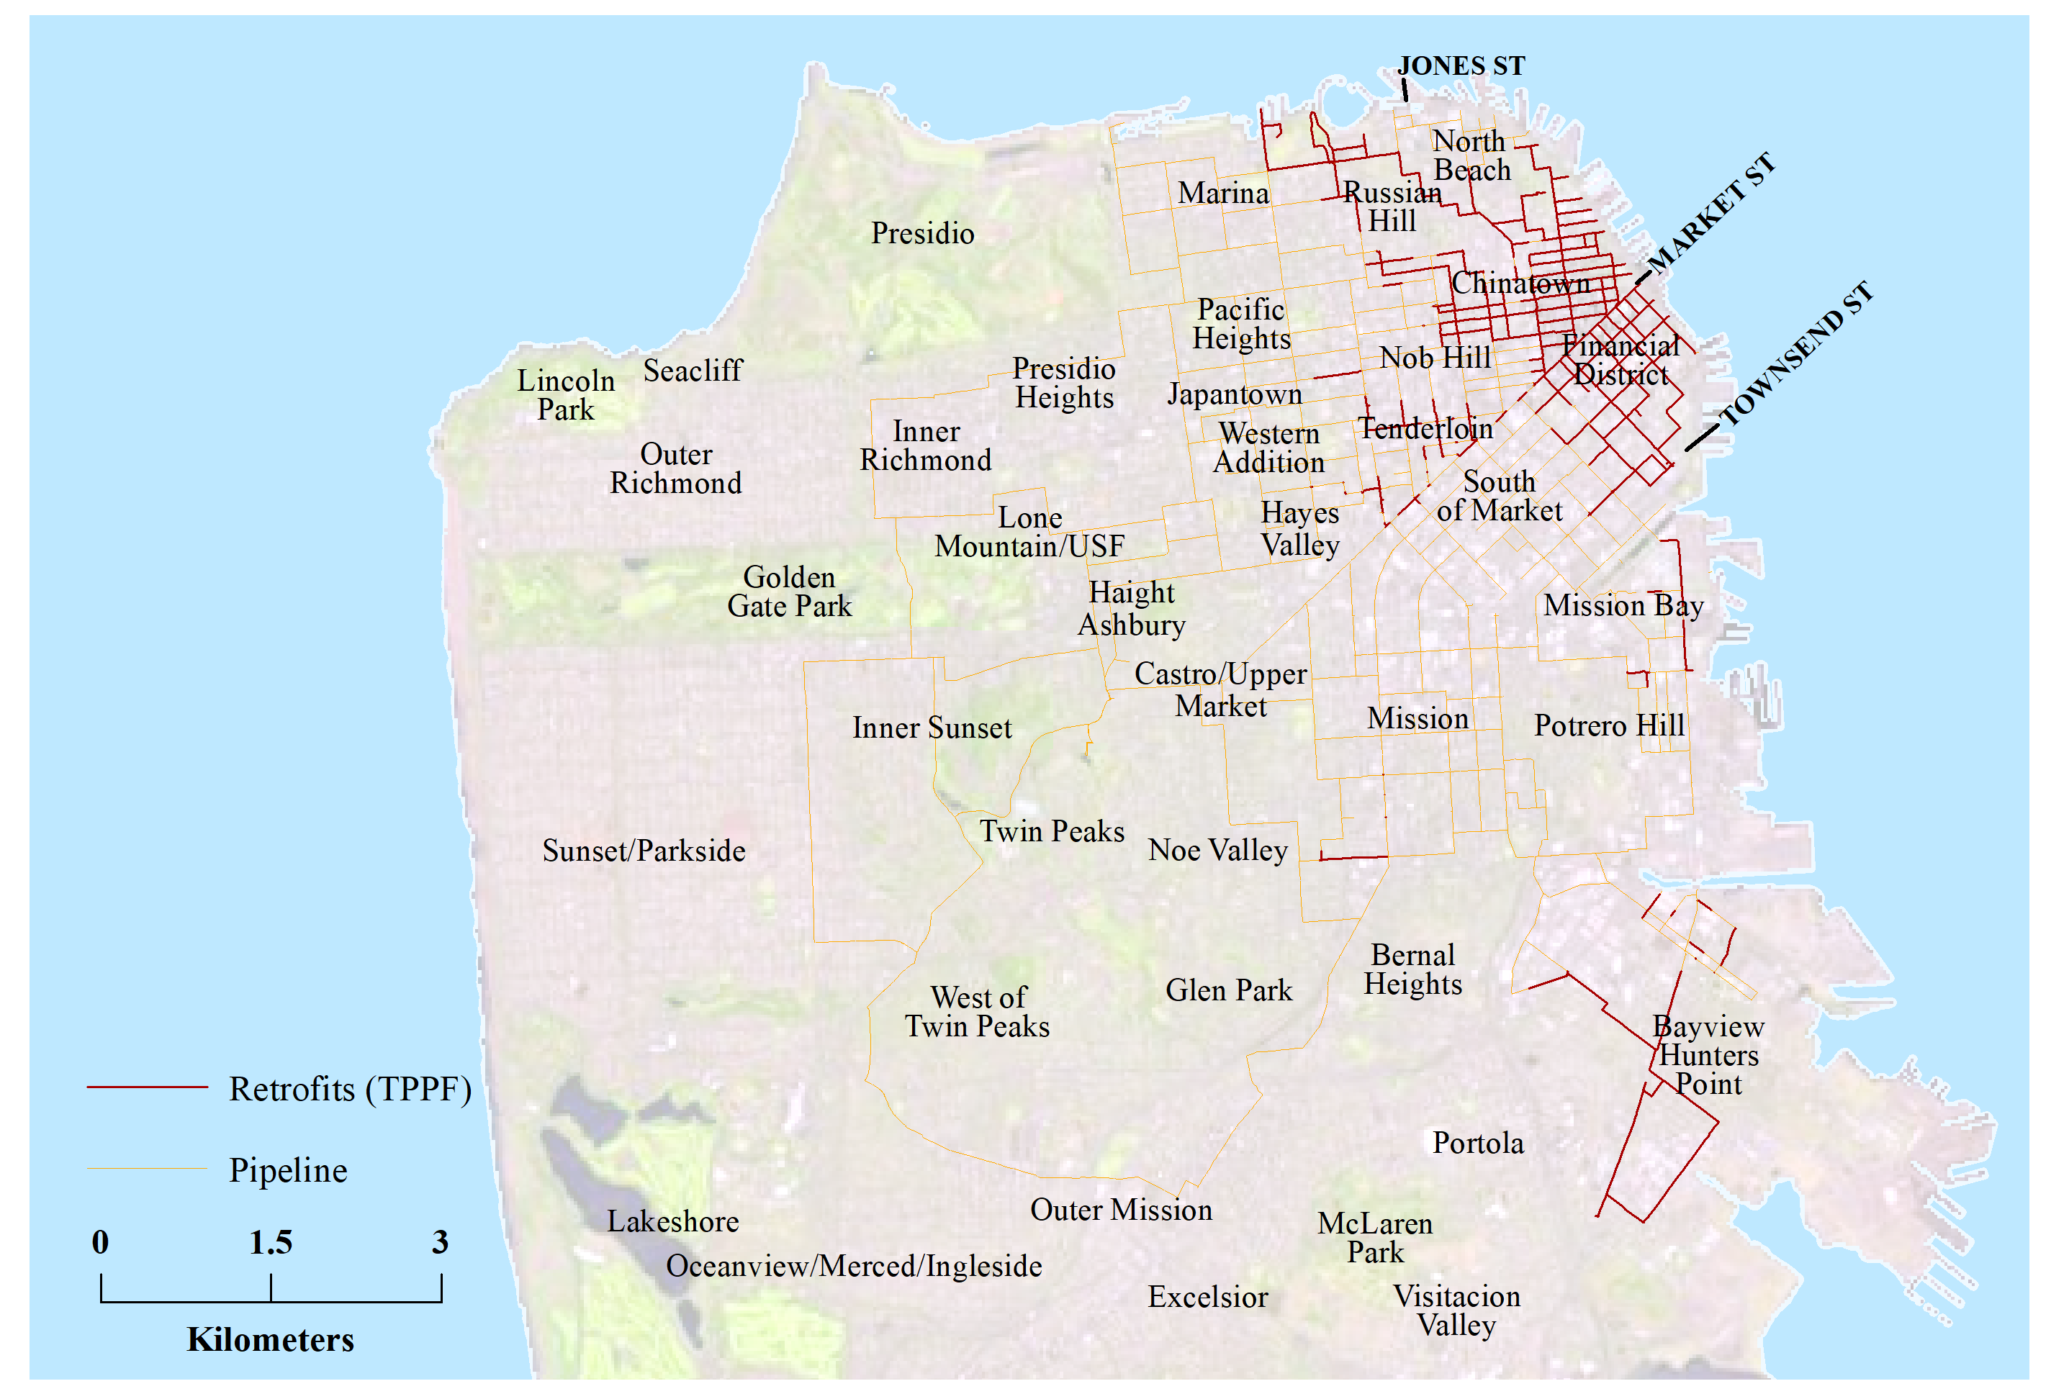
TPPF Retrofits
Chapter 4
Notes:
This map depicts the retrofit scheme using TPPF. Note that the retrofits do not extend down market street, but actually extends north from the financial district up to north beach and Russian hill. There is also some retrofits performed down in Bayview-Hunters point
Also recall that these two strategy had very similar performance in their retrofits, which is despite having fairly different retrofit schemes.

Slide 55
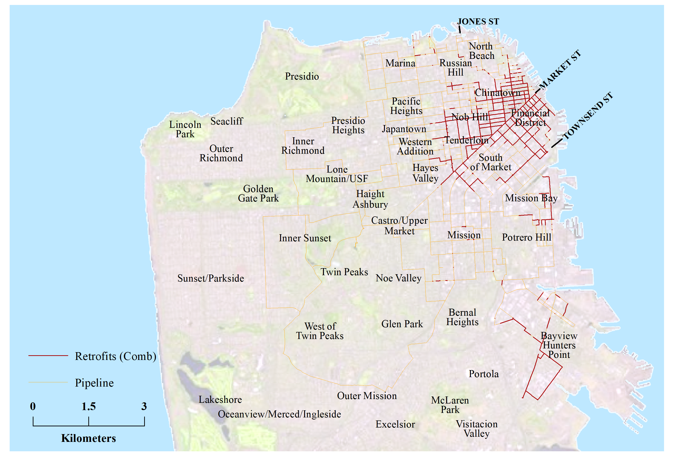
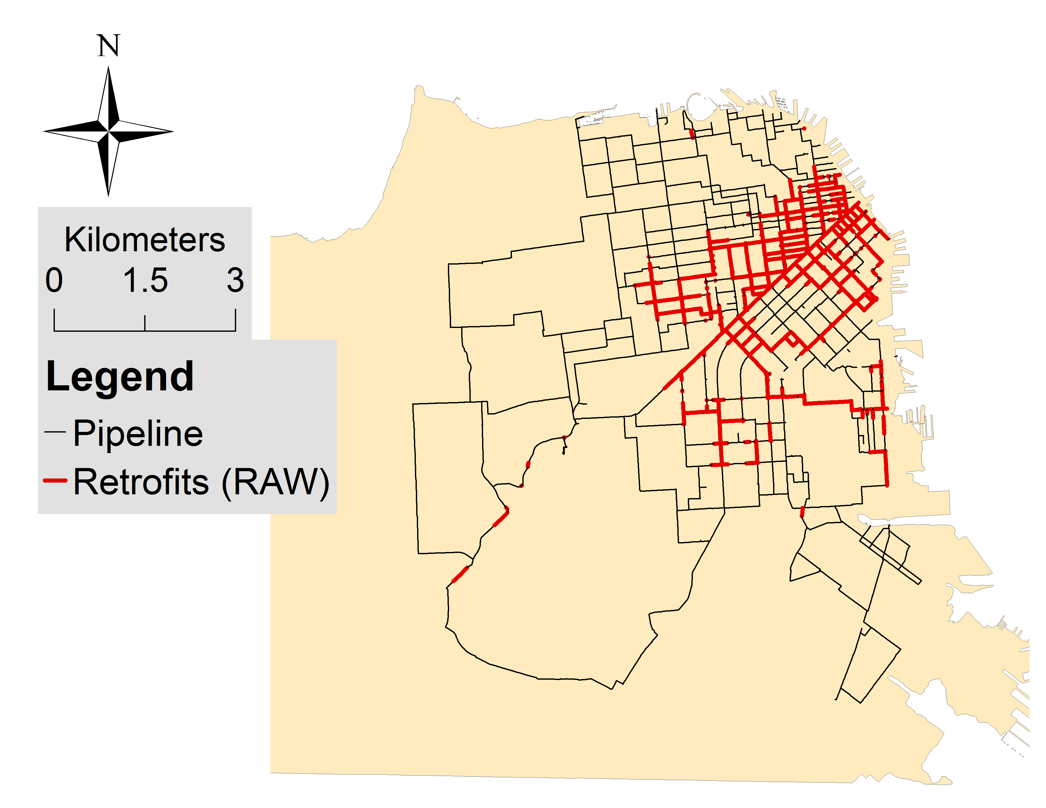
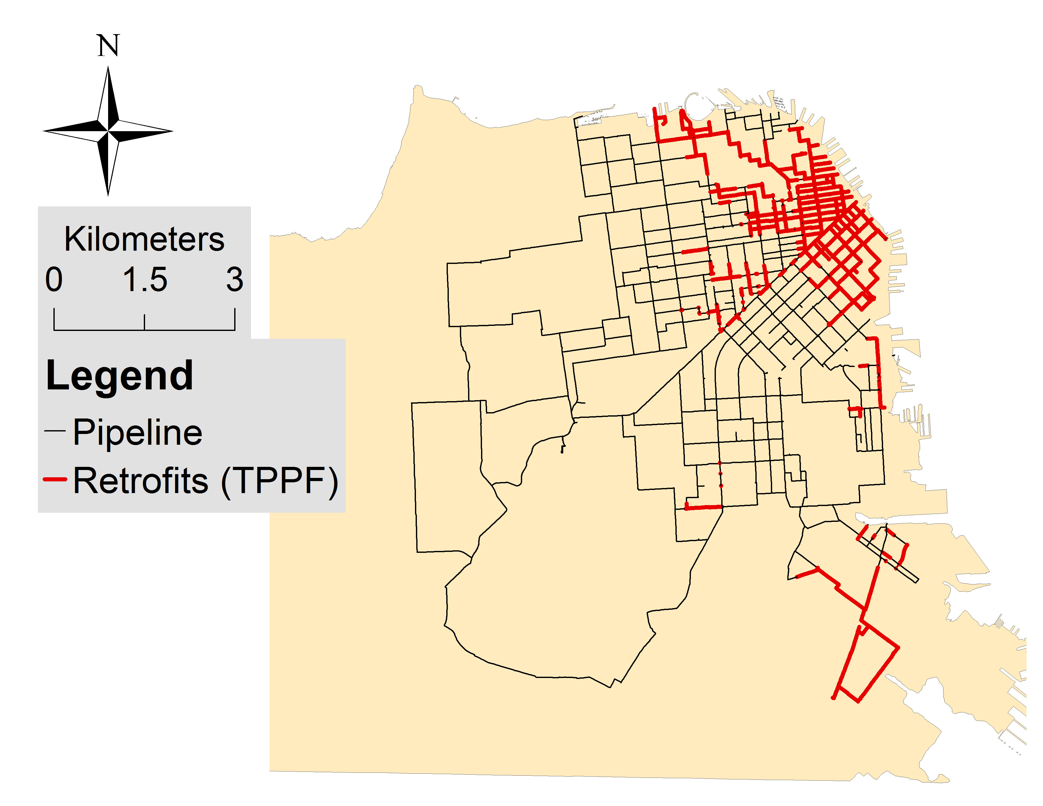
Combined Measure Retrofits
Chapter 4
One at a time
TPPF
Notes:
This map depicts the retrofits selected by combining the above two heuristics. For comparison, I have added mini maps depicting the retrofits of the previous two strategies in top left. If we compare this map with the minimaps, we see that the combined measure incorporates features from both maps. And its superior performance implies that this action improves upon the retrofits from the minimaps, individually.
Now, the dissertation performs more analysis, but in the interest of time, I’ll have to move on.
One of the difficulties in conducting the research for chapter 4 is that whenever I was testing a new retrofitting heuristic, I had to wait soooo long for the results to come in.
34-56
8:00
--------
22:00

Slide 56
Network Performance Estimation
Chapter 5
Recall: Physics based, hydraulic flow simulation
$$\begin{matrix} \\ \sum{Q_{in}}=\sum{Q_{out}}\end{matrix}$$
n = ##
Pipe
$$\begin{matrix} \\ z_{i}+\frac{p_{i}}{γ_{w}}+\frac{{v_{i}}^{2}}{2g}+h_{p}=z_{j}+\frac{p_{j}}{γ_{w}}+\frac{{v_{j}}^{2}}{2g}+h_{f}\end{matrix}$$
D = ##
L = ##
Notes:
The complexity of the calculations, combined with the complexity of my network, results in long computation time. There do exist other ways to evaluate network performance that are much more computationally efficient.

Slide 57
Network Performance Estimation
Chapter 5
Topological analysis
Notes:
For example, a popular method for analyzing networks is performing a topological analysis. In this strategy, damaged components are removed from the network topology, and the performance is based on the connectivity between source nodes and the distribution nodes of the network.
-----
For example, consider our example network.
---------
If these pipes were damaged during simulation,

Slide 58
Network Performance Estimation
Chapter 5
Topological analysis
Notes:
Then they are removed from the network like so. Then we check the connectivity between the source nodes
-------------
And our distribution nodes.
While this is easy to calculate, there may be some discrepancies between the results from this model and that of a physics based model.

Slide 59
Network Performance Estimation
Chapter 5
Topological analysis
Notes:
For example, consider this configuration. Both distribution nodes are connected to a source node, and thus this model says that these nodes have water. However, this may not be the case—since one of the source nodes is disconnected, there may not be enough water to adequately supply both distribution nodes. Or, due to the long travel path to the left distribution node, there may not be enough pressure or energy to propagate water to that node.
There are other non physical models that try to address these issues, but they also have some limitations.
Thus, as is the theme of this dissertation, I want the methodological rigor of physics based models, but with a smaller computational cost.

Slide 60
Network Performance Estimation
Chapter 5
Recall: Physics based, hydraulic flow simulation
Network Component Damage
Network Performance
Notes:
So again, if we think about our physics based simulation, we are just translating network component damage into an estimate of network performance.

Slide 61
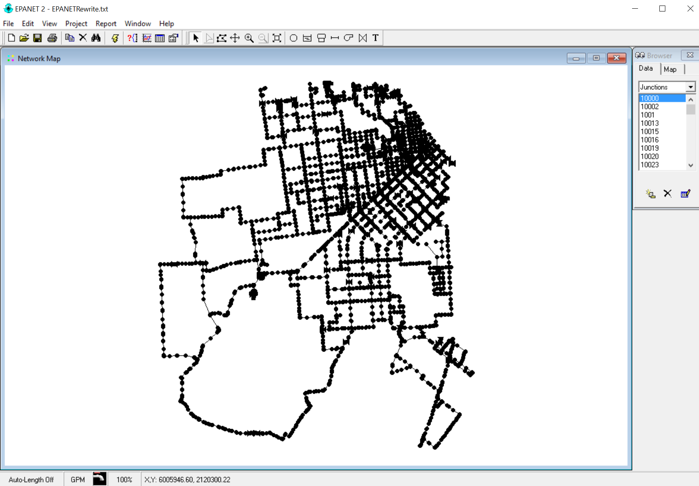
Network Performance Estimation
Chapter 5
Recall: Physics based, hydraulic flow simulation
Network Component Damage
Network Performance
Notes:
What if we take this perspective: we are taking our damage simulation, putting that into a black box, and this black box outputs network performance that reflects the satisfaction of the governing physical equations.

Slide 62
Network Performance Estimation
Chapter 5
Statistical Learning Model?
Network Component Damage
Network Performance
Notes:
And what if, we were to use a statistical learning model as this black box, that can translate our component damage into network performance estimates that reflect the satisfaction of the governing physical equations, but is also more computationally efficient? This is what chapter 5 of my dissertation proposes.

Slide 63
Random Forest
Chapter 5
Breiman (2001)
Aggregate of many trees
For each tree:
Bootstrap training data
Subset of variables (30%)
X₁ < x₁
X₂ < x₂
X₃ < x₃
X₄ < x₄
…
…
Y = f(X₁,X₂,X₃,…)
Notes:
The statistical learning technique I am using is Random Forest regression. Random Forest has been discussed for some time, but I believe the most modern version was first proposed by Breiman in 2001.
Random Forest models make predictions based on aggregating the predictions of many decision trees.
During model training, each tree is constructed in the following manner. First, the training data is bootstrapped, which is basically sampling with replacement, resulting in trees that may be constructed using different parts of the training data set.
Additionally, each tree only uses a subset of the input predictor variables—in my case, I used approximately 30% of the variables for each tree. This helps de-correlate the trees to improve the accuracy of predictions.
For those that are unfamiliar with trees, here is a quick example. Trees contain nodes like this, where a decision is made based on a particular variable. For example, if this variable is less than some value, then it goes in this direction. If not, then it goes in the other direction. In the next level, we make another decision using a different variable, and repeat the process, until we get to the very bottom of the tree, where the tree outputs a value based on which branches you take. These thresholds and the final values are determined during model training, and new data points traverse this tree to obtain these values during prediction.
*******************************
Subset of variables -> lower correlation between trees
Trees -> low bias
Aggregation -> low variance
This also gives us something called out-of-bag samples for each tree, which refer to training data that is not used in the construction of the particular tree. These out-of-bag samples can be used for testing or other calculations that I will mention later.

Slide 64
Random Forest
Chapter 5
Breiman (2001)
Aggregate of many trees
For each tree:
Bootstrap training data
Subset of variables (30%)
Easy to use, minimal tuning
Relatively quick calculation
Captures complex interactions between predictor variables
Low bias, low variance
X₁ < x₁
X₂ < x₂
X₃ < x₃
X₄ < x₄
…
Notes:
Now, I did consider other statistical learning techniques such as linear regressors like Lasso, support vector machines, and neural networks, but I ultimately chose random forests for their ease of use, relatively quick calculation time, ability to capture complex interactions between predictor variables, and its low bias and low variance.
In applying random forests to network performance estimation, I explored two different strategies.
Subset of variables -> lower correlation between trees
Trees -> low bias
Aggregation -> low variance

Slide 65
Naïve Strategy
Chapter 5
Component states as predictor variables → 6,307 variables
0
1
0
0
0
1
1
…
Network Component Damage
Pipe Damage
Random Forest
Notes:
First, in the Naïve strategy, I simply used the component states, or in other words the existence of pipe damage, as my predictor variables. There are a total of 6,307 predictor variables, each corresponding to a pipe segment.
For example, the first value in this vector describes the damage state of a pipe, and may be the decision variable for the first node of a decision tree.
One issue with this strategy is that for large networks we have a huge parameter space, and given limited training data, we may not be able to adequately capture this large parameter space.

Slide 66
Metric Strategy
Chapter 5
Translate component states into explanatory metrics
Use metrics as predictor variables
0
1
0
0
0
1
1
23
0.57
2e-3
…
…
Network Component Damage
Pipe Damage
Explanatory Metrics
Random Forest
Notes:
Thus, in the second strategy, I convert the component states into a smaller set of explanatory metrics, and then use these metrics as predictor variables instead. The objective is to be able to capture the impact of pipe damage to network behavior through these explanatory metrics, and at the same time, reduce the parameter space of the predictor variables.

Slide 67
Explanatory Metrics
Chapter 5
Metrics from literature
Metrics proposed here
Notes:
I don’t have time to describes all of the metrics I used here, so I’ll just describe them in general.
-------------
These metrics are either prominent metrics in the literature, or metrics that I have formulated in the dissertation

Slide 68
Explanatory Metrics
Chapter 5
Metrics from literature
Metrics proposed here
Topological
Flow/demand based
Notes:
The metrics could be topological in nature—that is, they are a function of the arrangement of components in the network--or flow/demand based.

Slide 69
Explanatory Metrics
Chapter 5
Metrics from literature
Metrics proposed here
Topological
Flow/demand based
Total of 23 explanatory metrics → 49 variables
Notes:
This dissertation explores a total of 23 explanatory metrics, which contributes 49 variables, as some metrics are specific to a particular source node, and there are 7 source nodes in my network.

Slide 70
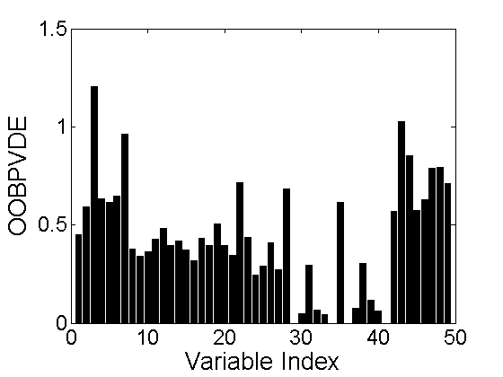
Variable Importance
Chapter 5
Out of bag permuted variable delta error (OOBPVDE)
Out of bag permuted variable delta error
Notes:
One feature of the random forest model is that we can estimate the importance of its predictor variables, using something called the out of bag permuted variable delta error. This value describes the impact of a predictor variable to prediction accuracy.
--------
We can compare this value for all predictor variables, like so, and be able to identify the most important variables.

Slide 71
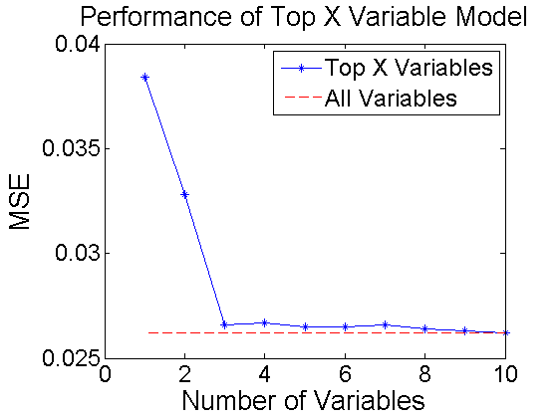
Variable Set Optimization
Chapter 5
Use only the most important variables
MSE (Prediction Error)
Notes:
Using this variable importance measure, we can think about, what happens if we just use only the most important variable in Random Forest; or the two most important variables, the three most important variables, etc.
---------
This plot depicts the performance of those models. The X axis describes the number of variables we include in the model, and the Y axis describes the Mean squared error, or MSE, a measure of the prediction error. This dashed red line describes the prediction error of the model using all variables, and the solid blue line describes the prediction error using a number of the most important variables. Interestingly, the blue line essentially converges with a model containing 3 variables, implying that I can achieve the same predictive power using just these 3 variables as compared to using all variables. For this presentation, I will be using the metric strategy using this optimized set of 3 variables.

Slide 72
Top 3 Important Variables
Spectral radius
Metric from literature that is related to dynamic phenomena in networks, such as the spread of viruses.
Proportion of affected tiers
Metric formulated in this dissertation defined to be the proportion of links that are downstream of damaged pipes.
Critical fraction
Metric from literature describing the theoretical value for the proportion of nodes which need to be removed to completely destroy the largest cluster in a network.
Notes:
For those that are curious, these are the top three most important variables used in the model.
First is spectral radius, a metric from literature related to dynamic phenomena in networks, such as the infection rate of viruses.
Second is the proportion of affected tiers, a metric formulated in this dissertation defined to be the proportion of links that are downstream of damaged pipes.
Third is the critical fraction, a metric from literature that describes the theoretical proportion of nodes that need to be removed to completely destroy the largest cluster in the network.

Slide 73
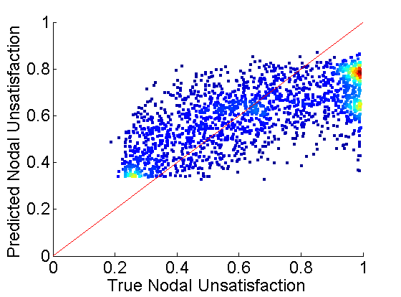
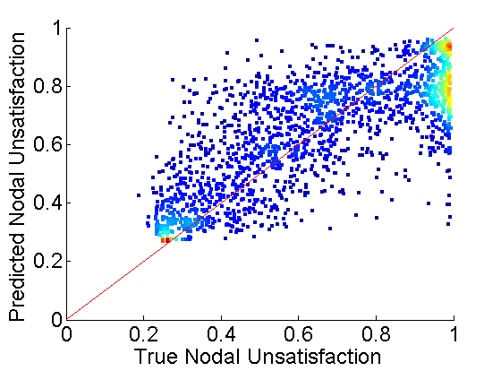
Predictive Power
Chapter 5
Naïve Model
MSE = 0.0343
Metric (Optimized) Model
MSE = 0.0266
Notes:
Random forest models using both strategies are constructed using a set of 1820 training data, and then tested using another set of 1820 data points.
These scatter plots describe the predictive power using these two different strategies. Each data point describes one simulation of pipe damage. The x axis is the true nodal unsatisfaction resulting from that damage, and the y axis is the predicted nodal unsatisfaction using our models. The coloration of the plots describe the density of the points, and the red line describes y = x, or when the prediction is exactly equal to the true value.
On the left, we have the Naïve model. We see that there is some correlation in these points, but many predictions seem to deviate from the true value, i.e. not following the red line. For example, there is a dense group of points on the right here, and a fairly dense group on the left side here. It seems that this model is unable to predict values above 0.8 and below about 0.35. This may be due to the large parameter space I mentioned earlier, and how it would be difficult to capture this space with limited training data. I also report here the overall MSE of this model, which is again a measure of prediction error.
On the right, we have the Metric model using our optimized set of 3 variables. We notice that the correlation between points is stronger and better match up with the red line, though there are still some deviations. But the dense cluster of points on the right is closer to the red line, same the dense cluster down on the left. This appears to perform better than the naïve strategy, and this is quantitatively reinforced by demonstrating a smaller MSE.
To further test these strategies, the model predictions are used in the calculation of the retrofit heuristic TPPF, and the resulting retrofits are evaluated.

Slide 74
Recall: TPPF Calculation
Chapter 4
Theoretical Pipe Participation Factor (TPPF)
After probabilistic risk assessment, retrofit pipe segments that are likely to be damaged in simulations that result in poor network performance.
$${TPPF}_{Component i}=\frac{1}{{Length}_{Component i}}\frac{1}{\sum_{j∈S_{D}}{w_{j}}}\sum_{j∈S_{D}}{w_{j}P\left(x_{i,j}≥x\right)}$$
Find ground motion simulations that result in high network disruption
(i.e. Nodal Unsatisfaction > 0.8)
Notes:
Recall that in the calculation of TPPF, we pick out simulations that have high network disruption, which is defined to be those that yield a nodal unsatisfaction above 0.8. So the models will be used to predict those simulations that are above that threshold.

Slide 75
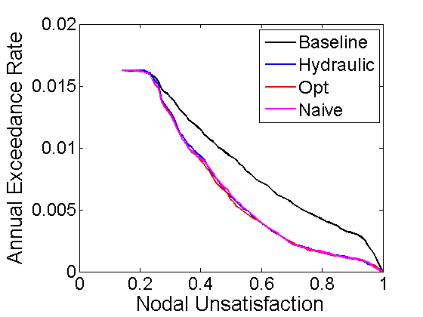
Application to Retrofit Selection
Chapter 5
Metric
..
Notes:
This plot depicts the network performance after we apply retrofits selected using the random forest models, in comparison with the retrofits selected using hydraulic simulation to calculate TPPF. Surprisingly, both random forest models match the hydraulic model very well, and this is despite the variability we saw in the previous scatter plot.

Slide 76
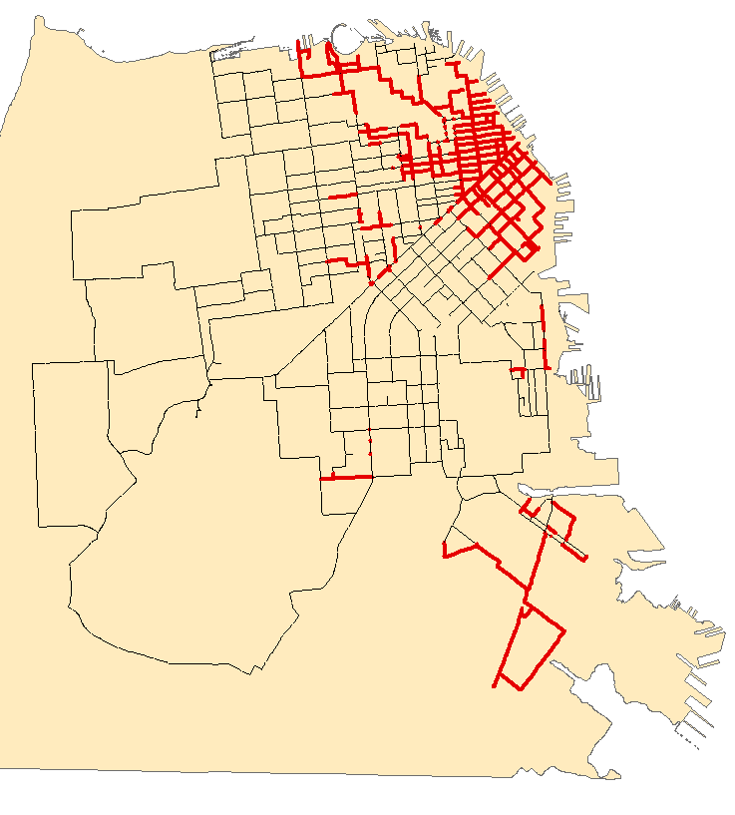
Application to Retrofit Selection
Chapter 5
Hydraulic Simulation
Metric (Optimized) Model
95% Match (by pipe length)
Notes:
To reinforce this, these maps depict the retrofits selected by these models in comparison to those selected using hydraulic simulation. As you can see, the pipe selection is very similar.
------------------
In fact, 95% of the pipes match between the two. How is this possible?

Slide 77
Recall: TPPF Calculation
Chapter 4
Theoretical Pipe Participation Factor (TPPF)
After probabilistic risk assessment, retrofit pipe segments that are likely to be damaged in simulations that result in poor network performance.
$${TPPF}_{Component i}=\frac{1}{{Length}_{Component i}}\frac{1}{\sum_{j∈S_{D}}{w_{j}}}\sum_{j∈S_{D}}{w_{j}P\left(x_{i,j}≥x\right)}$$
Find ground motion simulations that result in high network disruption
(i.e. Nodal Unsatisfaction > 0.8)
Notes:
First, let’s take another look at TPPF. Recall that we used the models to determine those simulations that go into this set S_D. In doing so, we are actually changing this from a regression problem, in which we predict values, to a classification problem, in which we label simulations to be in or out of this set.

Slide 78
Implied Classification Problem
Chapter 5
Notes:
With this thought, let’s take another look at the scatter plot.

Slide 79

Implied Classification Problem
Chapter 5
Notes:
If we draw these dashed black lines at the thresholds of 0.8, we can make the follow interpretation. The points in the bottom left quadrant are correctly labeled to be below this threshold, and the points on the top right quadrant are correctly labeled to be above this threshold.

Slide 80
Implied Classification Problem
Chapter 5
0.0648
0.1467
0.6225
0.1659
Notes:
These numbers reflect the proportion of data found in each of these quadrants.

Slide 81
Implied Classification Problem
Chapter 5
0.0648
0.1467
0.6225
0.1659
Notes:
If we sum these two numbers, we get the proportion of data that is correctly labeled, or the classification accuracy. Here, we have a classification accuracy of about 75%
However, we can also think about this: the data that is used in the TPPF calculation are those that are predicted to be above the threshold.

Slide 82
Implied Classification Problem
Chapter 5
0.0648
0.1467
0.6225
0.1659
Notes:
So these two values. The top left describes the proportion of data that are false positives, and incorrectly included in the TPPF calculation. If we find the ratio of these two values, we find that 30% of the data in TPPF are incorrectly included. I call this value, the proportion of confounding data.
So in the implied classification problem, we have a 75% classification accuracy, and 30% proportion of confounding data, and yet, we were able to match the retrofits so well.
One possible explanation is that the confounding data actually does select at least a subset of the important pipes, and this is reinforced by the correctly labeled data.
Another explanation is could be that the weights of the correctly labeled data are higher than the confounding data, which is not reflected in this scatter plot.
In any case, these findings demonstrate the ability of these random forest models to replicate the results of hydraulic simulation in terms of retrofit selection.

Slide 83
Computational Advantages for Subsequent Estimates
Chapter 5
Hydraulic Simulation
Simulation = 1000 seconds/data point
Total (1,820 points) = 1,800,000 seconds
Naïve Random Forest
Model training = 60,000 seconds
Prediction = < 1 second/data point
Total (1,820 points) = 60,000 seconds
Metric (Optimized) Random Forest
Precalculations = 60 seconds
Metric calculation = 1.5 seconds/data point
Model training = 60 seconds
Prediction = < 1 second/data point
Total (1,820) = 3,000 seconds
1/30
1/600
Notes:
Finally, I would like to talk about the computational advantages of using statistical learning techniques over hydraulic simulation. This slide records the computation time for subsequent estimates of network performance—in this case, for a new set of 1,820 data points. These computation times are empirical, and were recorded on this very laptop.
If we use hydraulic simulation, we run them in GIRAFFE, which takes a total of around 1,800,000 seconds.
If we use Naïve Random forest, most of the time is spent on model training, which results in a total of 60,000 seconds, || which is 1/30th of the computation time as compared to hydraulic simulation.
If we use the Metric strategy with the optimized set of variables, most of the time is spent on metric calculation, which results in a total of 3,000 seconds, which is 1/600th of the computation time as compared to hydraulic simulation.
Of course, these numbers assume that we already have labeled training data. But still, this demonstrates the potential for statistical learning techniques for the efficient estimation of network performance that replicates results from physics based hydraulic simulation.
57-84
18:30
-------------
40:30

Slide 84
Contributions of this Dissertation
Facilitate probabilistic analysis of infrastructure network reliability.
Integrate seismic risk of network components to enable risk informed retrofit selection.
Develop methods that are rigorous but computationally tractable for complex networks.
Notes:
To summarize this presentation, I will discuss the contributions of this work in terms of the objectives of this dissertation.

Slide 85
Contributions of this Dissertation
Facilitate probabilistic analysis of infrastructure network reliability.
Established a framework to combine probabilistic seismic risk analysis and retrofit selection in a structured manner
Demonstrated that risk informed heuristics contribute to superior retrofits
Notes:
Recall that the first objective was to facilitate probabilistic analysis of networks. This dissertation established a framework that details probabilistic seismic risk analysis and combines it with retrofit selection in a structure manner. This dissertation also demonstrated that risk informed heuristics contribute to superior retrofits.

Slide 86
Contributions of this Dissertation
Integrate seismic risk of network components to enable risk informed retrofit selection.
Detailed the calculation of a risk informed retrofit heuristics, the TPPF and the Combined Measure
Notes:
The second objective was to integrate seismic risk considerations into retrofit selection. This dissertation detailed the calculation of risk informed retrofit heuristics, including the TPPF and the Combined Measure.

Slide 87
Contributions of this Dissertation
Develop methods that are rigorous but computationally tractable for complex networks.
Proposed heuristics to estimate pipe importance for retrofit selection
Applied statistical learning techniques for efficient estimation of network performance
Notes:
Finally, the third objective was to develop methods that are rigorous, but computationally tractable for large complex networks. This dissertation proposes heuristics that may be easily calculated to effectively select retrofits. This dissertation also applied statistical learning techniques that replicated the results of physics based hydraulic simulation that are much more computationally efficient.

Slide 88
Limitations & Future Work
Further evaluation of robustness, generality for other networks
Additional failure modes
Liquefaction
Facility damage
Alternative retrofit evaluation metrics
Financial loss metrics
Network recovery time
Time dependent components of framework
Deterioration/maintenance of network components
Growth projection of networks
Time dependent seismic hazard
Notes:
I would like to mention a few limitations to the findings in this work, as well as discuss avenues for future work.
First, the methods proposed in this research are demonstrated on this one case study network, so these methods may be further evaluated in terms of their robustness and their generality for the application to other networks.
Additionally, this work only considers pipe damage from ground shaking, but there exist other failure modes such as liquefaction, and damage and shutdown of facilities in the network.
This dissertation evaluates retrofits according to the network performance metric, nodal unsatisfaction. We can also think about other metrics to evaluate our retrofits, such as financial loss due to loss of network services, as well as network recovery time.
Furthermore, we can think about the evolution in time of various components of the framework, such as the fragility of network components via deterioration or maintenance actions, growth of the network, and the evolution of the seismic hazard over time.

Slide 89
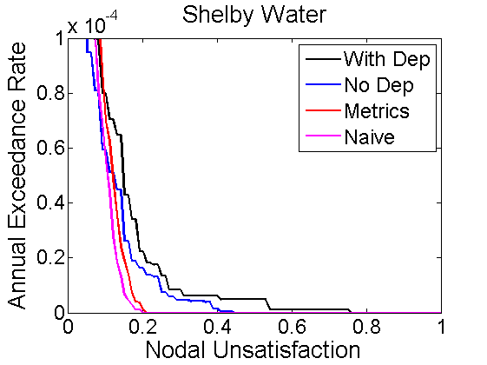
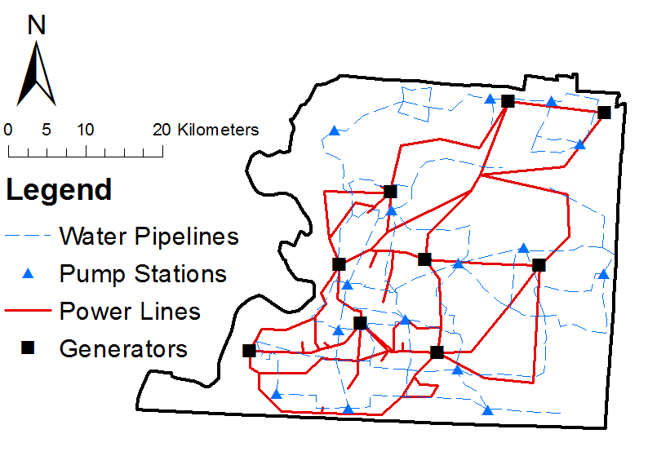
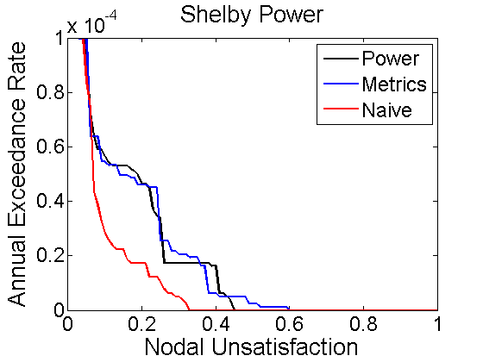
Limitations & Future Work
Multihazard, multinetwork analysis
Shelby County
Notes:
Finally, the concepts presented in this work can be applied to other hazards and other networks, such that we can perform multihazard and multinetwork analysis. In fact, I have been applying the methods proposed in this dissertation to another area, Shelby County, and its interdependent water and power networks. I do have some preliminary results as shown here, but this is still an ongoing project. These preliminary results are discussed in Appendix B of my dissertation.

Slide 90
Thank you
Notes:
And with that I would like to thank you all for listening.
85-91
3:30
------
44:00

Slide 91
Acknowledgements
Jack Baker

Slide 92
Acknowledgements
Anne Kiremidjian, Greg Deierlein

Slide 93
Acknowledgements
Leonardo Dueñas-Osorio, Greg Beroza

Slide 94
Acknowledgements
David Myerson and SFPUC
Charlie Scawthorn
Tom O’Rourke
Ram Rajagopal and Yizheng Liao

Slide 95
Acknowledgements
Baker Research Group

Slide 96
Acknowledgements
Friends

Slide 97
Acknowledgements
Family

Slide 98
Acknowledgements
Whitney

Slide 99
Acknowledgements
Funding

Slide 100
Questions?
Hazard
Network
Retrofit
Framework
AWSS
Retrofitting
Statistical Learning

Slide 102
Extras

Slide 103
Hazard Characterization
Chapter 2
Enumerate possible future earthquake scenarios.
Determine the probabilistic distribution of ground motion for each scenario.
Obtain realizations of ground motion intensities
Optimize the set of ground motion maps
Notes:
Now, in order for me to best reinforce and retrofit my networks, I need to know what hazards I am up against, hence this first module of the framework.
Ideally, I would just predict the future, know what ground shaking I would be up against, and then act accordingly.
However, since I can’t do that, the next best thing is to think about all of the different possible

Slide 104
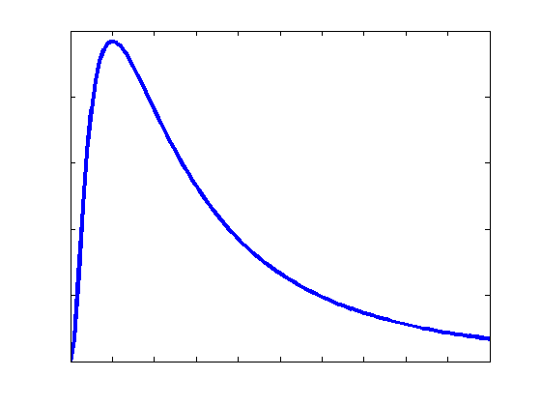
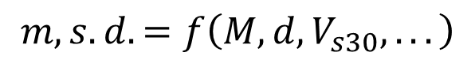
Hazard Characterization
Chapter 2
Enumerate possible future earthquake scenarios.
Calculate the median and dispersion of the ground motion.
$$m,s.d.=f\left(M,d,V_{s30},...\right)$$
Notes:
Next, we calculate the median and dispersion of the ground motion at various sites for each earthquake scenario. We typically assume lognormal distributions of ground motion, and these parameters may be calculated as a function of earthquake magnitude, distance from rupture, soil conditions, etc. using ground motion prediction equations.

Slide 105
Network Performance Estimation
Chapter 2
Translate ground motion intensities into network component probability of failure.
Simulate component damage.
Estimate network performance due to that damage.

Slide 106
Network Retrofit Selection
Chapter 2
Select network components for retrofitting
Integrate seismic risk considerations
Elaborated in Chapter 4

Slide 107
Network Performance Estimation
Chapter 5
Topological analysis
R
T
Notes:
Then they are removed from the network like so. Then we check the connectivity between the source nodes
-------------
And our distribution nodes.

Slide 108
Network Performance Estimation
Chapter 5
Network flows
R
T

Slide 109
Network Performance Estimation
Chapter 5
Network flows
R
T

Slide 110
Contributions of this Dissertation
Facilitate probabilistic analysis of infrastructure network reliability.
Chapter 2; Chapter 4
Integrate seismic risk of network components to enable risk informed retrofit selection.
Develop methods that are rigorous but computationally tractable for complex networks.

Slide 111
Contributions of this Dissertation
Facilitate probabilistic analysis of infrastructure network reliability.
Chapter 2; Chapter 4
Integrate seismic risk of network components to enable risk informed retrofit selection.
Chapter 2; Chapter 4
Develop methods that are rigorous but computationally tractable for complex networks.

Slide 112
Contributions of this Dissertation
Facilitate probabilistic analysis of infrastructure network reliability.
Chapter 2; Chapter 4
Integrate seismic risk of network components to enable risk informed retrofit selection.
Chapter 2; Chapter 4
Develop methods that are rigorous but computationally tractable for complex networks.
Chapter 3; Chapter 4; Chapter 5

Slide 113
Chapter 3 Material

Slide 114
Ground Motion Simulation
+
=
Median
Residual
Realization

Slide 115
Ground Motion Simulation
+
=
Median
Residual
Realization

Slide 116
Methods for Generating Epsilon
Covariance Method (Goovaerts 1997)
Sequential Simulation Method (Goovaerts 1997)
Spectral Simulation Method—FFT Algorithm (Fenton 1990)
Turning Bands Method (Dietrich 1995)
Circulant Embedding Method (Kroese and Botev 2013)

Slide 117
Methods for Generating Epsilon
Covariance Method (Goovaerts 1997)
Sequential Simulation Method (Goovaerts 1997)
Spectral Simulation Method—FFT Algorithm (Fenton 1990)
Turning Bands Method (Dietrich 1995)
Circulant Embedding Method (Kroese and Botev 2013)

Slide 118
Covariance Method (Goovaerts 1997)
1
2
3
4
4 x 4 = 16 sites
16 x 16 Matrix

Slide 119
Sequential Simulation Method (Goovaerts 1997)
Avoids calculation of entire covariance matrix! (Screening Effect)
1
2
3
4
1
1
1
1
1
2
2
2
2
2
3
3
3
3
3
4
4
4
4
1
2
3
4
4

Slide 120
Spectral Method - FFT (Fenton 1990)
Avoids calculation of entire covariance matrix!
1
2
3
4
4 x 4 = 16 sites
4 x 4 Matrix

Slide 121
Turning Bands Method (Dietrich 1995)
4 x 4 = 16 sites
1
2
3
4
13
14
15
16

Slide 122
Turning Bands Method (Dietrich 1995)
1) Create a number of lines at different angles from an origin

Slide 123
Turning Bands Method (Dietrich 1995)
1) Create a number of lines at different angles from an origin
2) Simulate values on each line within each band (1D simulation)

Slide 124
Turning Bands Method (Dietrich 1995)
1) Create a number of lines at different angles from an origin
2) Simulate values on each line within each band (1D simulation)
3) Project each point in your site grid to each line

Slide 125
Turning Bands Method (Dietrich 1995)
1) Create a number of lines at different angles from an origin
2) Simulate values on each line within each band (1D simulation)
3) Project each point in your site grid to each line

Slide 126
Turning Bands Method (Dietrich 1995)
1) Create a number of lines at different angles from an origin
2) Simulate values on each line within each band (1D simulation)
3) Project each point in your site grid to each line
4) Sum the values to obtain realized value

Slide 127
Circulant Embedding (Kroese and Botev 2013)
1
2
3
4
4 x 4 = 16 sites
16 x 16 Matrix

Slide 128
Circulant Embedding (Kroese and Botev 2013)
Covariance matrix fully defined by the first row (if gridded)
1
2
3
4
4 x 4 = 16 sites
16 x 16 Matrix

Slide 129
Circulant Embedding (Kroese and Botev 2013)
Covariance matrix fully defined by the first row (if gridded)
Eigenstructure for circulant matrices well known

Slide 130
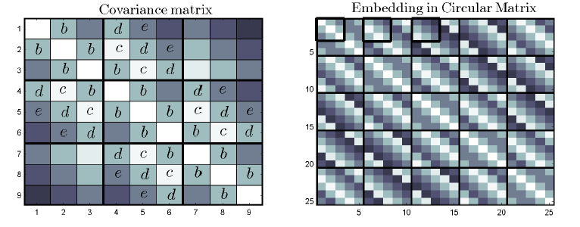
Circulant Embedding (Kroese and Botev 2013)
Obtain covariance values
Embed values into a block circulant matrix
Kroese and Botev (2013)

Slide 131
Circulant Embedding (Kroese and Botev 2013)
Obtain covariance values
Embed values into a block circulant matrix
Compute the eigenvalues of circulant matrix, γ
First row/column of circulant matrix → G
Γ = real(FFT2(G))
Γ must be non-negative definite
Simulate Random Field

Slide 132
Flexibility
Covariance, Sequential, Turning Bands can operate with irregularly spaced sites
Spectral requires
Rectangular grid
Equal spacing
Circulant Embedding requires:
Rectangular grid
Equal spacing
Non-negative definite embedded matrix
Flexibility
Covariance
Sequential
Spectral
Turning Bands
Circulant Emb.
Best
Middle
Worst

Slide 133
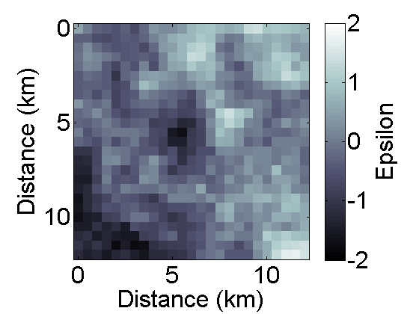
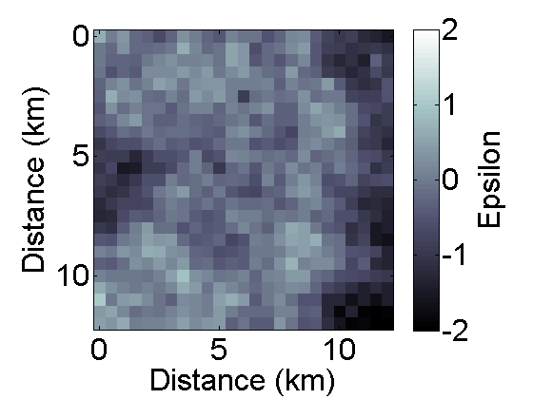
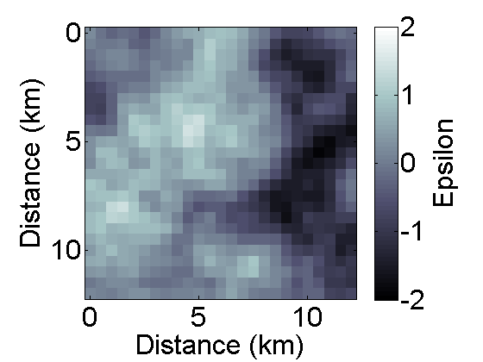
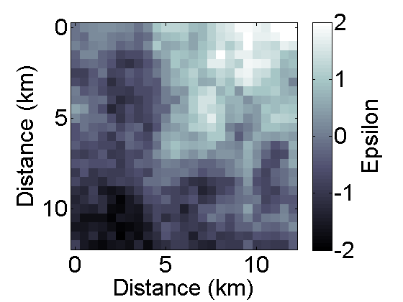
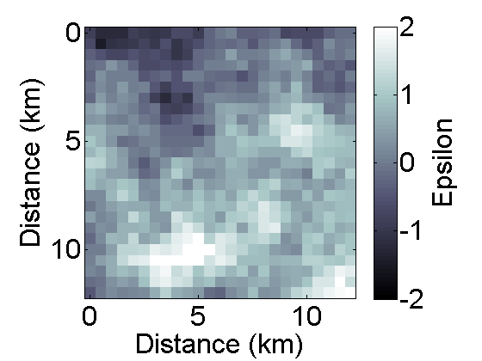
Accuracy
Covariance
Sequential
Spectral
Turning Bands
Circulant Embedding

Slide 134
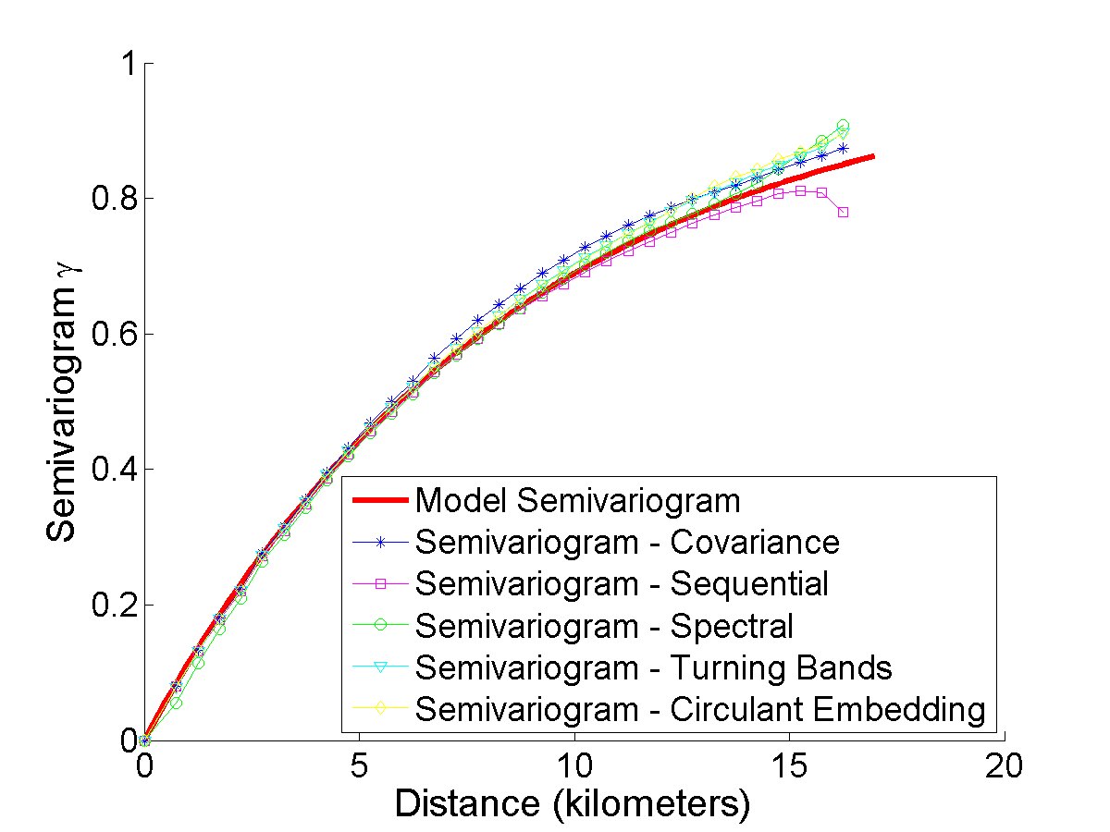
Accuracy

Slide 135
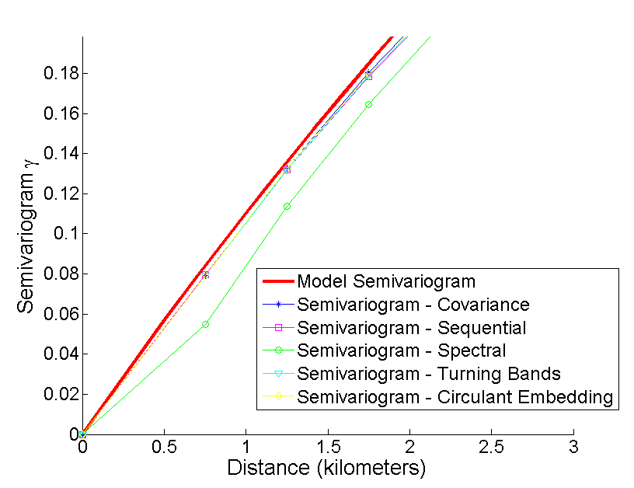
Accuracy
Accuracy
Covariance
Sequential
Spectral
Turning Bands
Circulant Emb.
Best
Middle
Worst

Slide 136
Computational Complexity
Covariance Method
O(N³) (Precalculations)
O(N²) (Simulations)
N = number of sites
Sequential Method
O(N*ν³)
N = number of sites
ν = number of conditioning sites
Spectral Method
O(N*log(N))
N = number of sites
Turning Bands Method
O(N*L*q*log(q))
N = number of sites
L = number of lines
q = number of bands
Circulant Embedding
O(N*log(2*sqrt(N))
N = number of sites

Slide 137
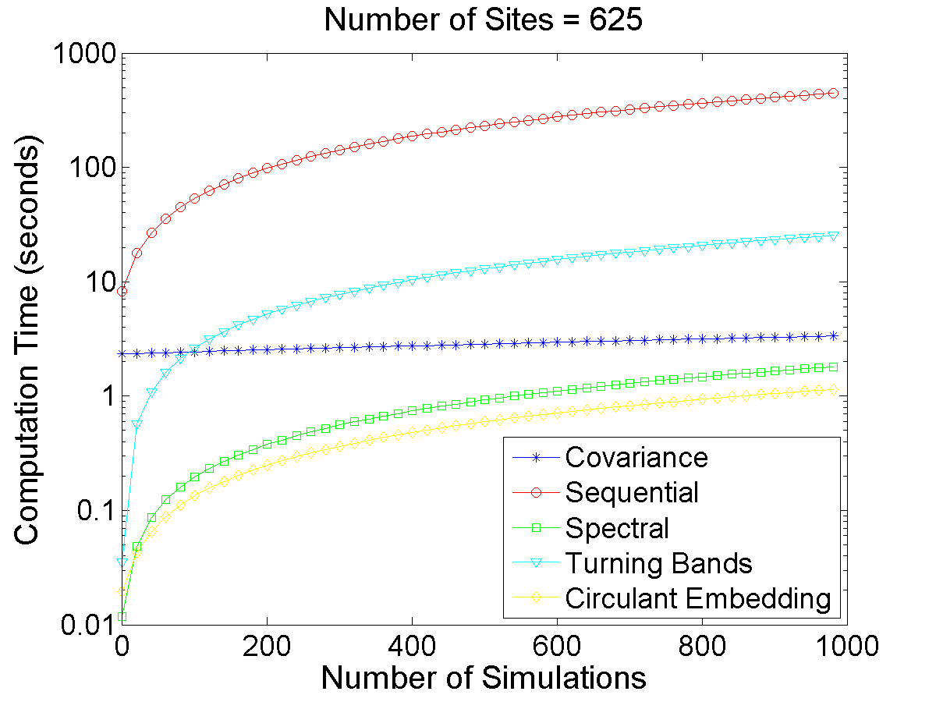
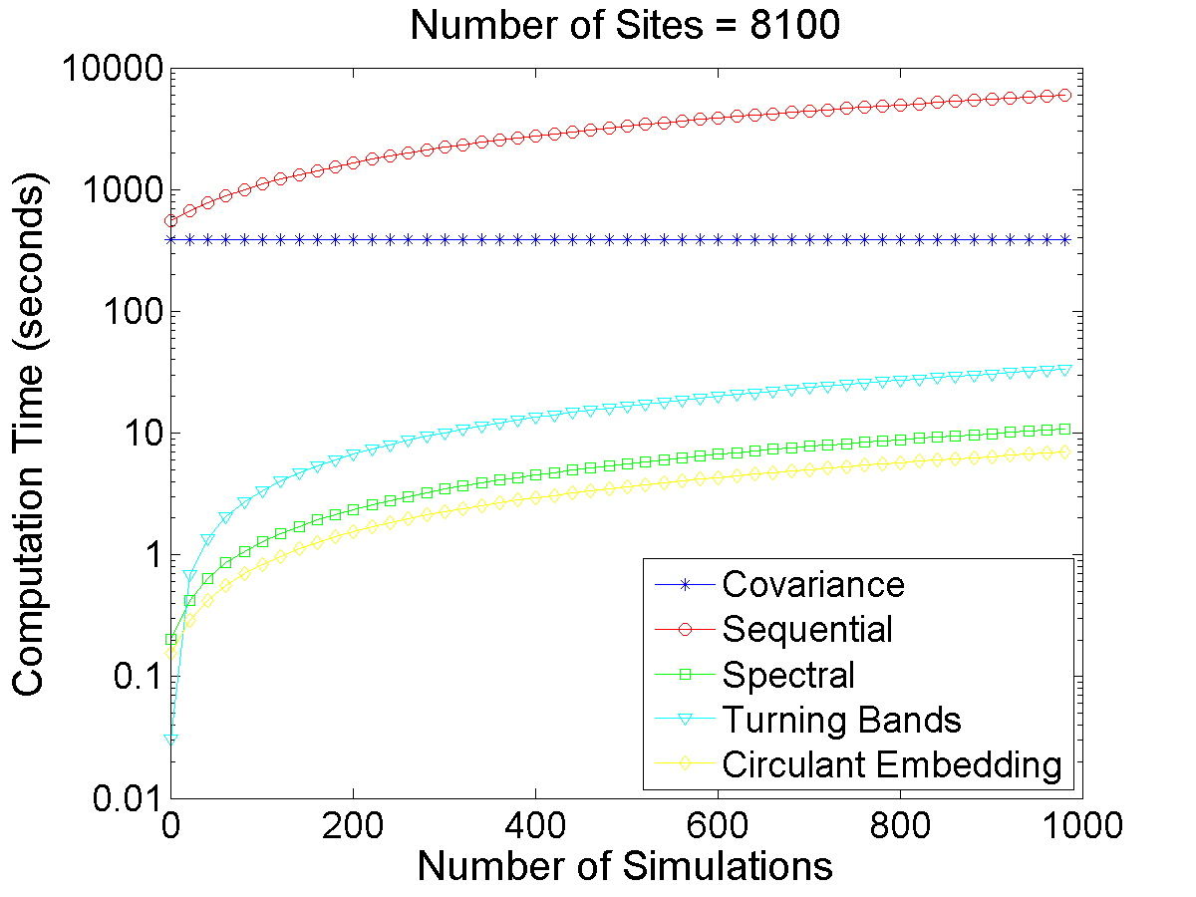
Computation Time
Comp. Time
Covariance
Sequential
Spectral
Turning Bands
Circulant Emb.
Best
Middle
Worst

Slide 138
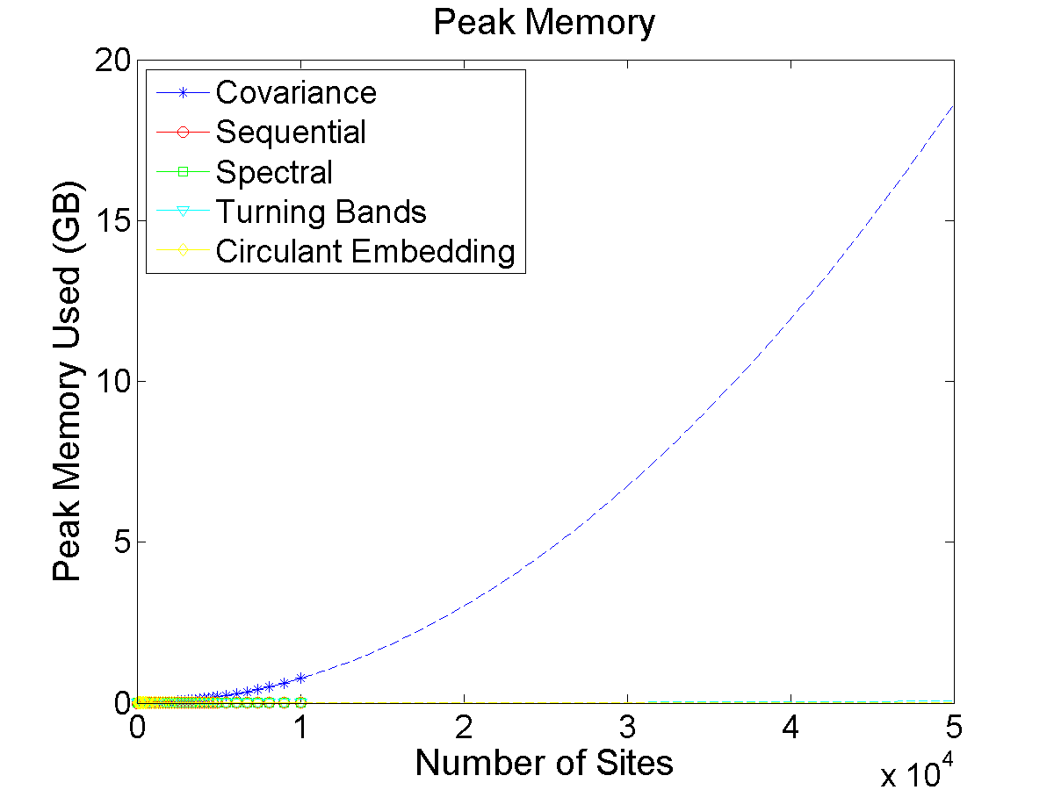
Peak Memory
Memory
Covariance
Sequential
Spectral
Turning Bands
Circulant Emb.
Best
Middle
Worst

Slide 139
Ease of Implementation
Implementation
Covariance
Sequential
Spectral
Turning Bands
Circulant Emb.
Best
Middle
Worst

Slide 140
Summary of Evaluation
Implementation
Flexibility
Accuracy
Comp. Time
Memory
Covariance
Sequential
Spectral
Turning Bands
Circulant Emb.
Best
Middle
Worst

Slide 141
Recommendations
For small number of sites (<1000)
Covariance/Sequential Methods
Ease of implementation outweigh small disadvantages in computation
For large number of sites (>1000)
For irregularly spaced sites
Turning Bands Method
For gridded sites
Spectral/Circulant Embedding Methods
F
A
C
M
I
CV
SQ
SP
TB
CE

Slide 142
Chapter 4 Material

Slide 143
Break One at a Time Retrofits
Chapter 4

Slide 144
TPPF Retrofits
Chapter 4

Slide 145
Combined Measure Retrofits
Chapter 4
One at a time
TPPF

